Slide 1
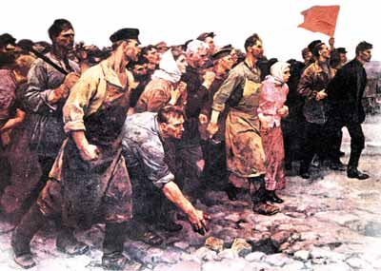
Russian Imperialism and Communism
Outcome: The Russian Revolution

Slide 2
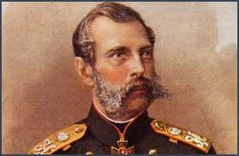
The Russian Revolution
Setting the Stage: Ripe for Revolution
Cruel and oppressive rule of 19th Century czars caused social unrest
1881, reformist Czar Alexander II assassinated by upset revolutionaries

Slide 3
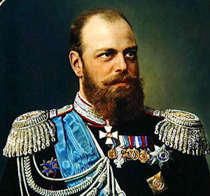
Czar Alexander III

Slide 4
The Russian Revolution
Czars Resist Change
Alexander III halted all reforms and clung to autocracy (total control)
Anyone who questioned the czar, worshipped outside of Russian Orthodox Church, or spoke another language was labeled dangerous
Alexander censored published materials, teachers, and students
Forbade minority languages, targeted the Jews
Died of kidney inflammation in 1894, son Nicholas II takes over

Slide 5
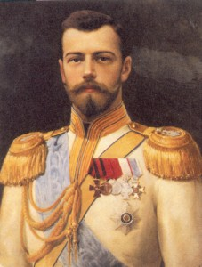
Czar nicholas II

Slide 6
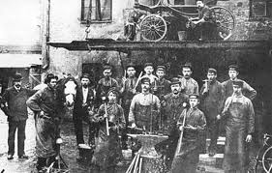
The Russian Revolution
Russia Industrializes
Number of factories doubled between 1863 and 1900; still behind Europe
Industrialization brought new problems: high taxes, bad working conditions, low wages, & child labor
Trade unions outlawed; unhappy workers organized strikes
Marxist (those who followed ideas of Karl Marx) revolutionaries believed:
The industrial class would overthrow the czar and form a “dictatorship of the proletariat”
Proletariat: the workers
The proletariat would rule the country
Marxists split into two groups: Mensheviks and Bolsheviks

Slide 7
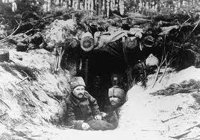
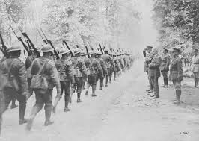
The Russian Revolution
Three Crises Show Czar’s Weaknesses
Russo-Japanese War (Cost lives & $$$)
Bloody Sunday: The Revolution of 1905 (Failed revolution)
World War I (Cost lives & $$$)

Slide 8
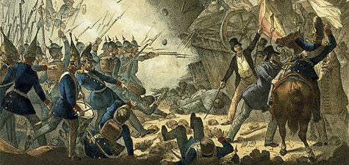
The March Revolution

Slide 9
The Russian Revolution
The March Revolution
Prices were wildly inflated
Food and supplies were dwindling
March of 1917, women textile workers in Petrograd led a city-wide strike
In the next 5 days, shortages of bread and fuel led to riots.
200,000 workers swarmed the streets shouting “Down with the autocracy!”
Rasputin, holy man who gained political power was poisoned and shot
This uprising led Czar Nicholas II to abdicate his throne

Slide 10
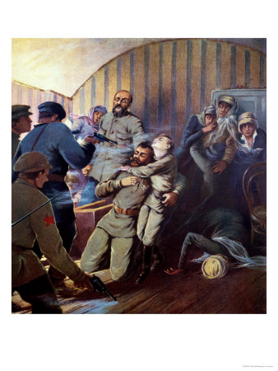
The Russian Revolution
The March Revolution
Nicholas and his family were executed by revolutionaries a year later

Slide 11
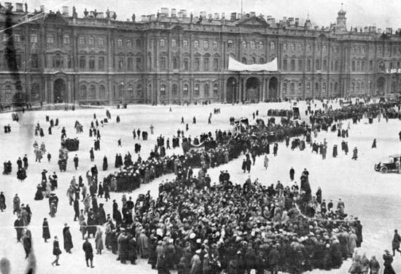
The Russian Revolution
The March Revolution
A provisional government (temporary government) was set up
Socialist revolutionaries formed soviets
Soviets: local councils consisting of workers, peasants, and soldiers

Slide 12
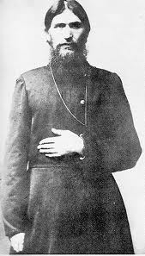
Rasputin

Slide 13
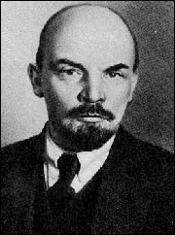
Vladimir Lenin

Slide 14
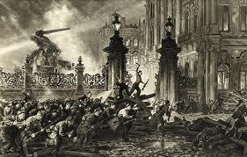
The Russian Revolution
The Bolshevik Revolution
Vladimir Lenin returns to Russia from exile (via Germany)
The provisional government topples after Bolshevik Red Guards storm Winter Palace in Petrograd (St. Petersburg)

Slide 15
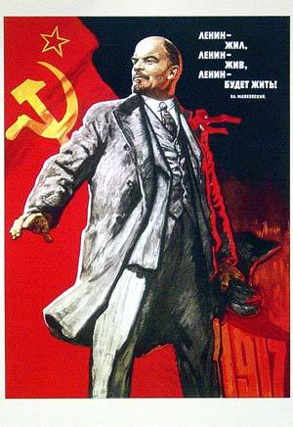
The Russian Revolution
The Bolshevik Revolution (continued…)
The Bolsheviks are in power within days behind Lenin
Lenin gave control of factories to the workers (Communal ownership)
Lenin distributes all farmland to the peasants (Communal ownership)
Civil War erupts in Russia (Bolsheviks vs. those loyal to Czar regime)

Slide 16
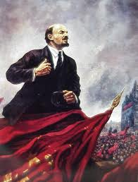
The Russian Revolution
The Bolshevik Revolution (continued…)
Lenin restores order and in 1922 Russia is renamed the Soviet Union
Bolsheviks rename themselves the Communists

