Slide 1
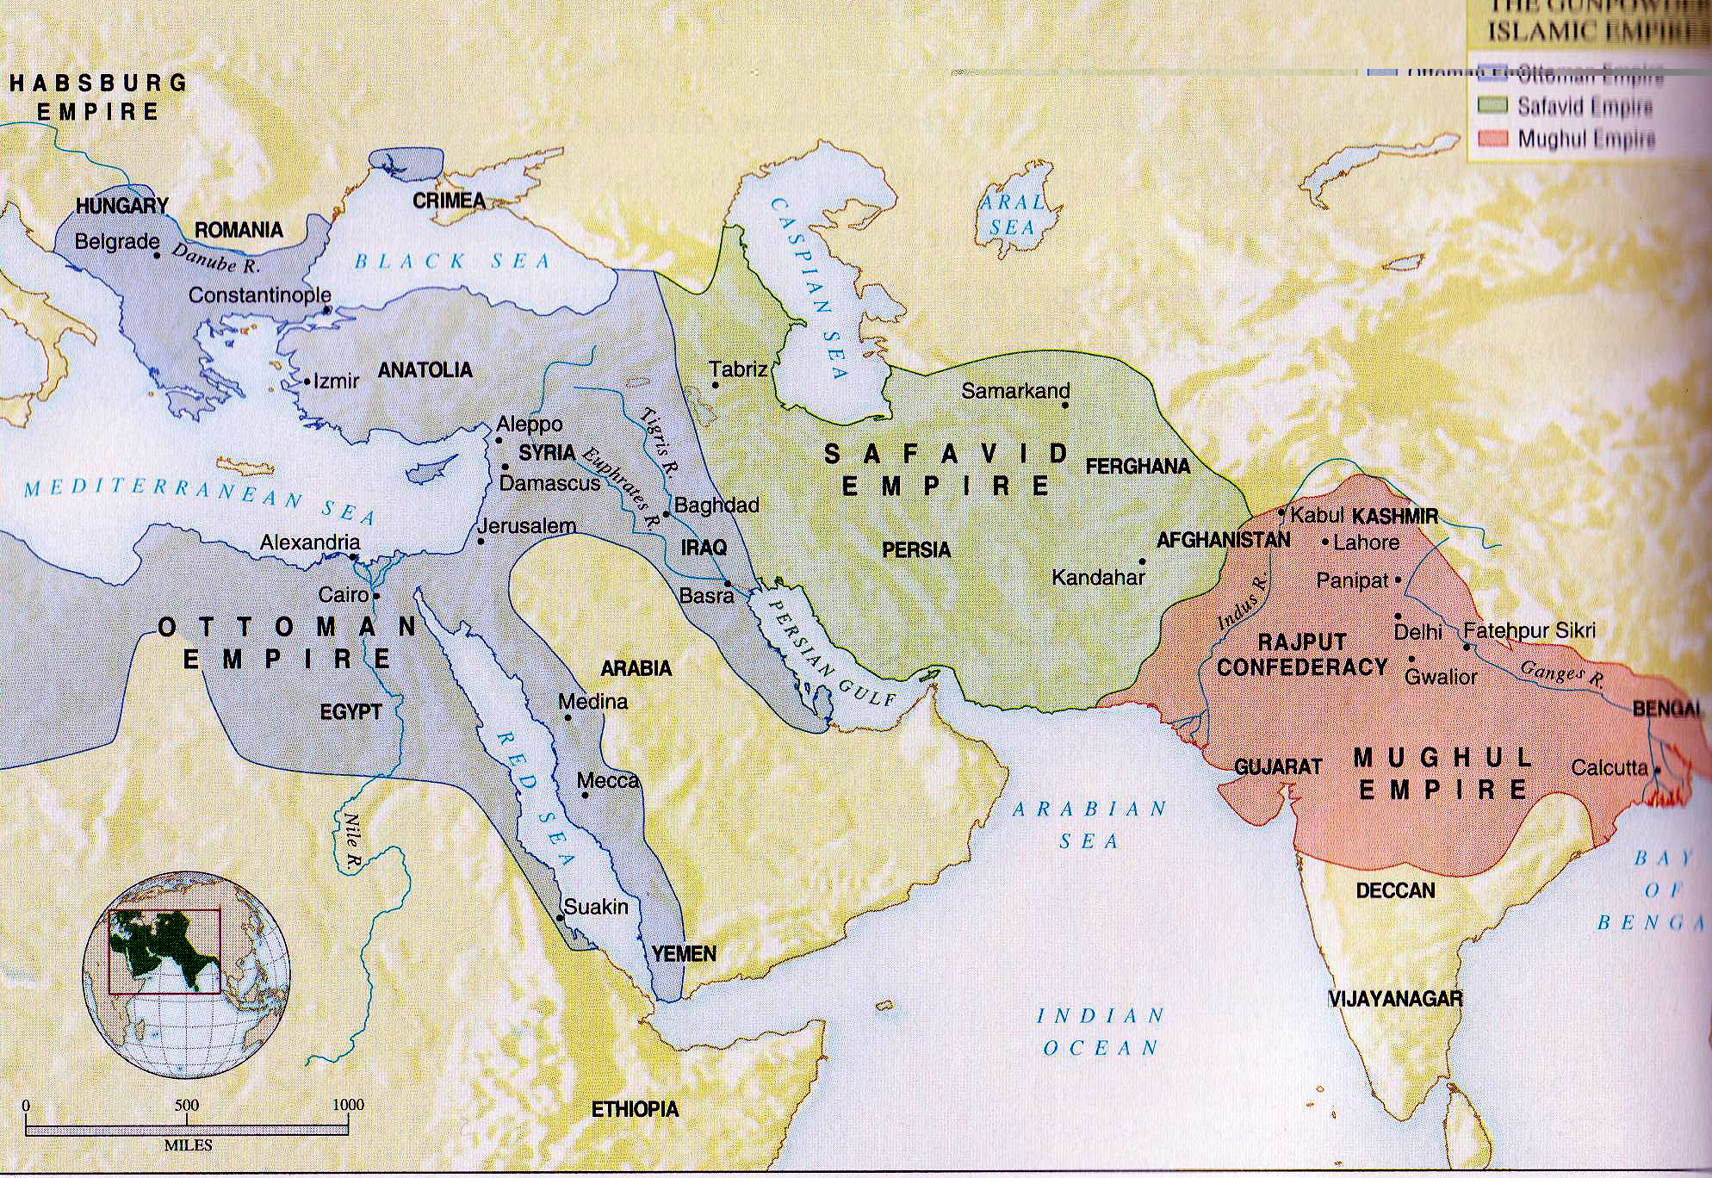
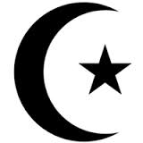
Islam
Outcome: Islamic Empires

Slide 2
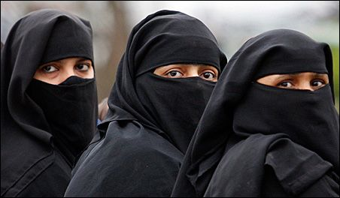
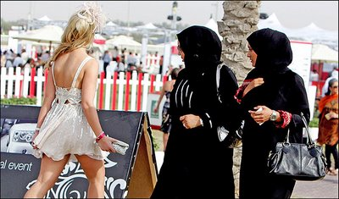
Islamic Empires
Setting the Stage: Islamic Culture
The Qur’an says “Men are the managers of the affairs of women” and “Righteous women are therefore obedient.”
Qur’an also declares that men and women, as believers, are equal

Slide 3
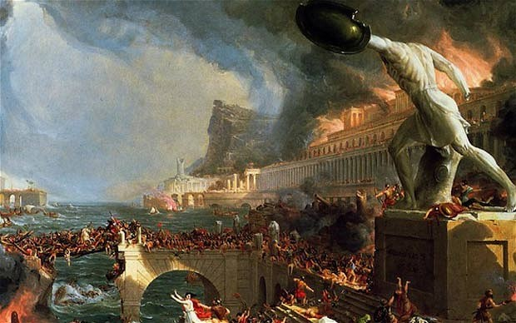
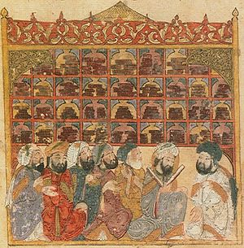
Islamic Empires
After the fall of Rome in 476, Muslim scholars preserved and expanded much of the scientific knowledge that had been gained

Slide 4
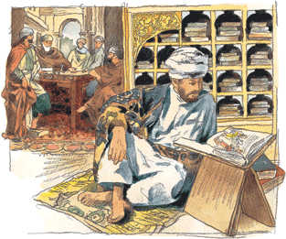
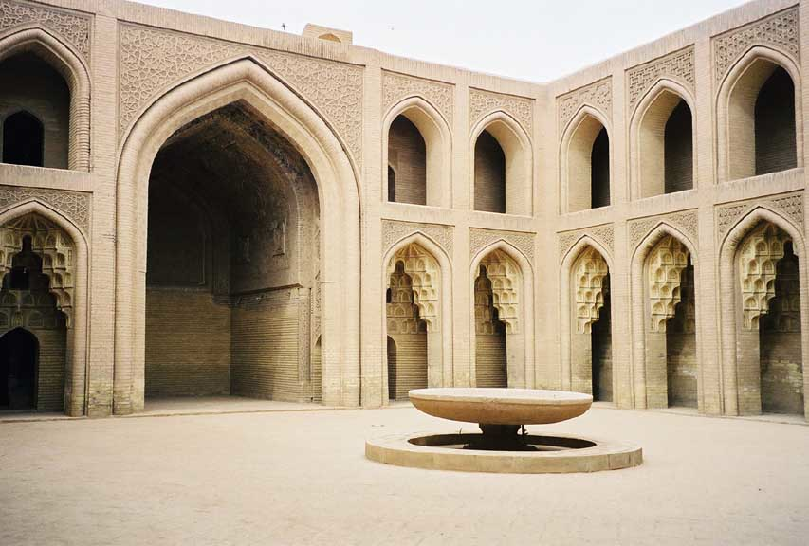
Islamic Empires
In early 800s, the House of Wisdom was built in Baghdad; place where different cultures worked side by side to translate texts from Greece, India, Persia and elsewhere into Arabic

Slide 5
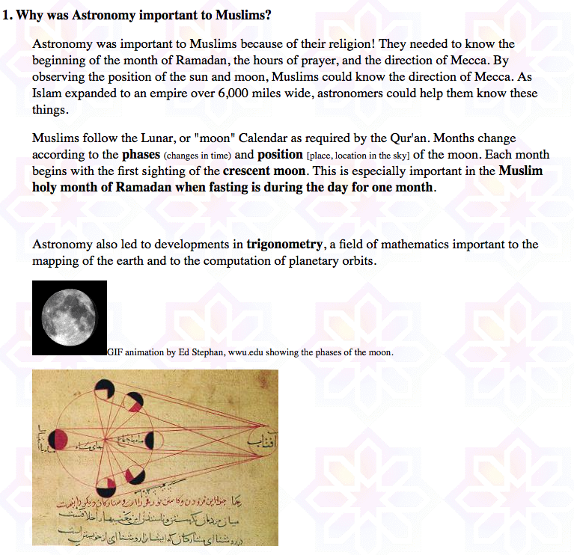
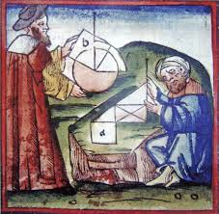
Islamic Empires
Muslim scientists made many advances in mathematics and astronomy

Slide 6
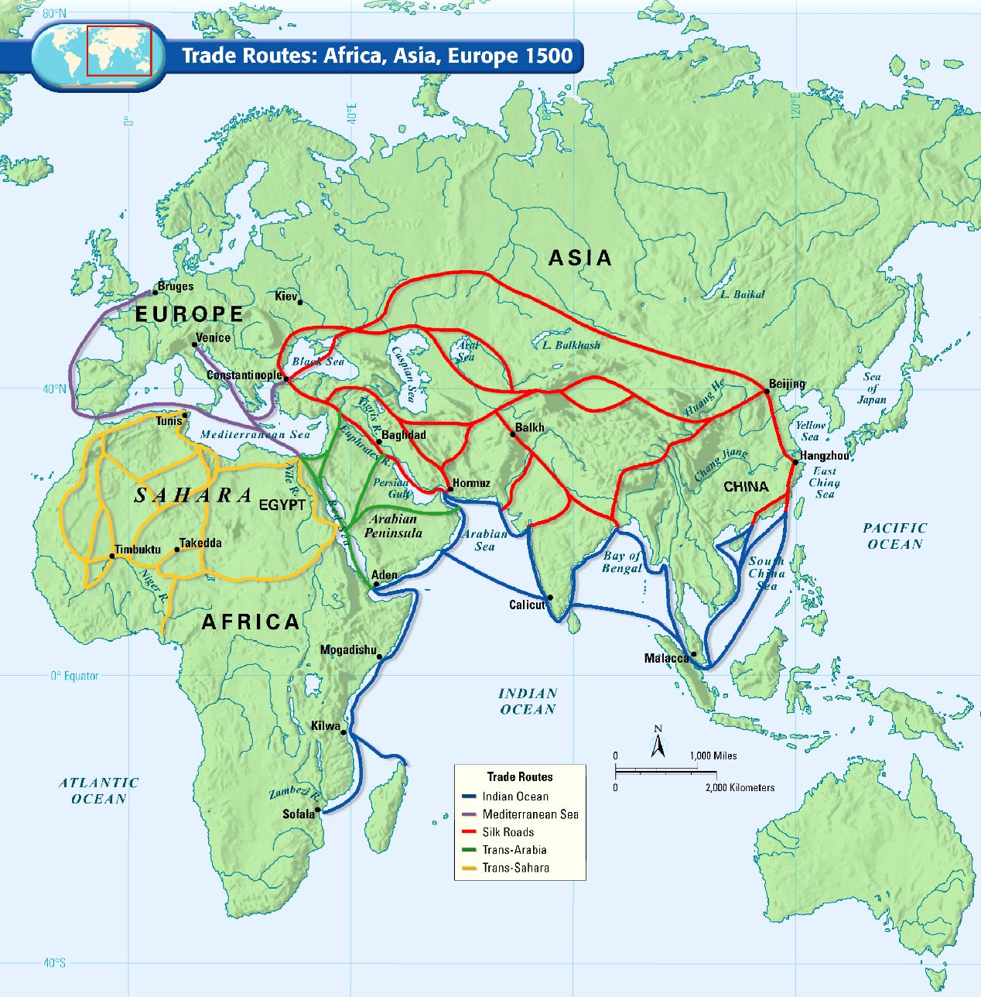
Muslims will introduce the idea of slavery into Africa long before the Europeans begin the African Slave Trade

Slide 7
Islamic Empires
Islam led to the rise of three important empires: The Ottomans, Safavids, and Mughals

Slide 8
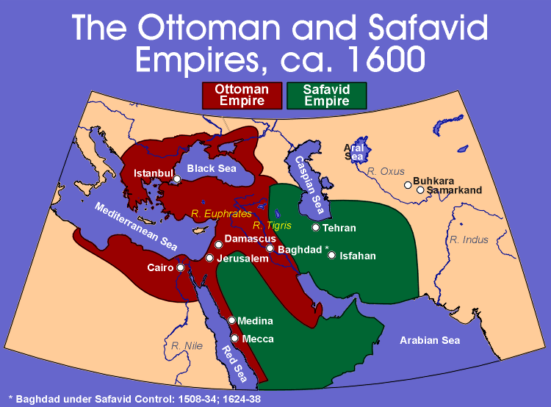
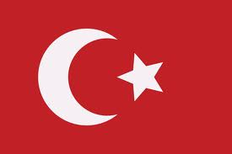
The Ottoman Empire

Slide 9
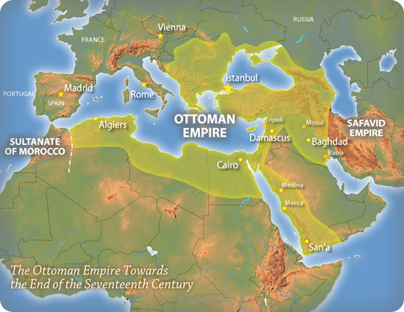

Slide 10
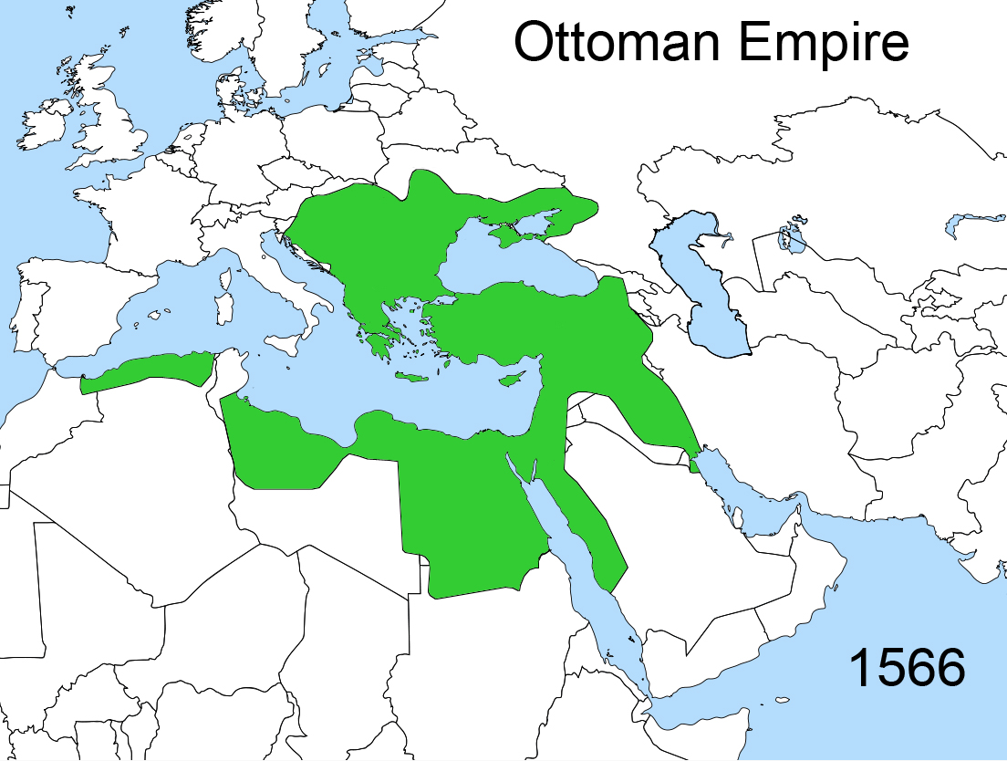
Islamic Empires
The Ottoman Empire
Where were they located?
Byzantium & Anatolia (Modern day Turkey)
By 1566, lands included Hungary in the North, Egypt in the South, Algeria in the West, and Mesopotamia in the East

Slide 11
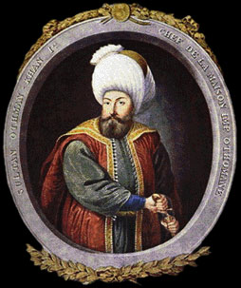
Islamic Empires
Who were they?
Anatolia was home to many descendents of nomadic, militaristic Turks who had a long history of invading other countries
Many Anatolian Turks saw themselves as ghazis, or warriors for Islam
Osman was the most successful ghazi; followers called Ottomans in the West
Ottomans successful military relied on gunpowder
Osman

Slide 12
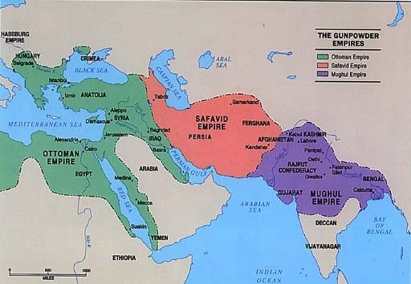

Slide 13
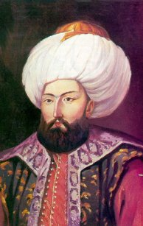
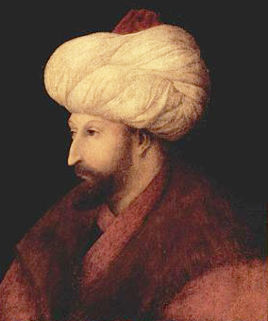
Islamic Empires
Mehmed I and Mehmed II led expansion of empire through 1566
Mehmed II captured Constantinople and opened it to Jews, Christians, and Muslims; Muslims renamed it Istanbul
Mehmed I
Mehmed II

Slide 14
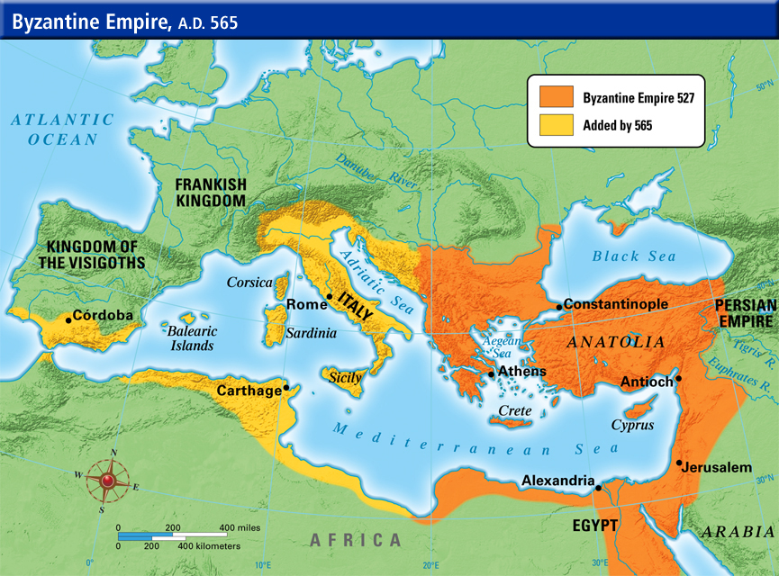
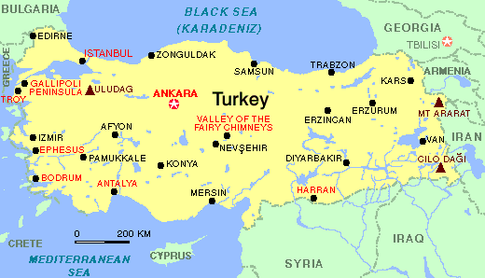

Slide 15
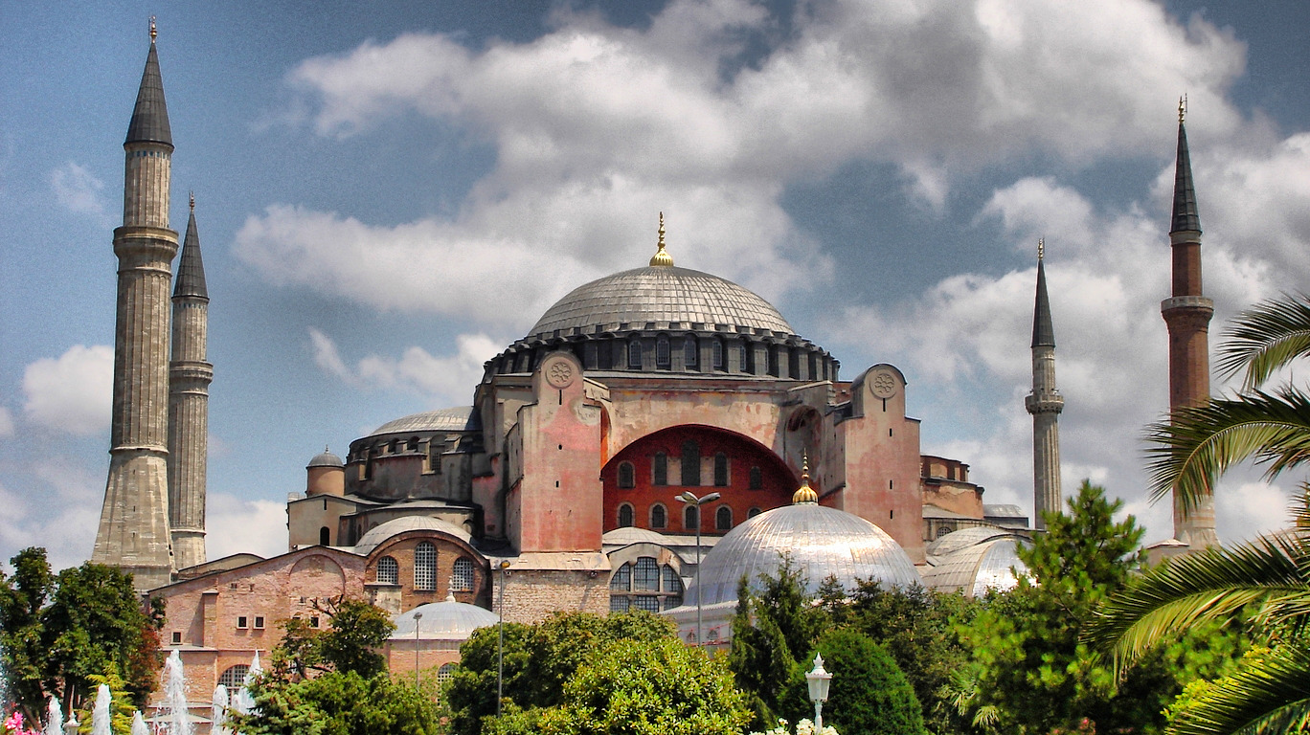
The Hagia Sophia Becomes a Mosque

Slide 16
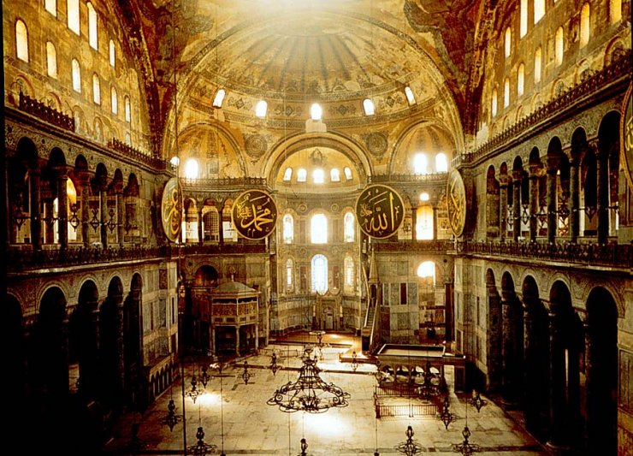
Inside the Hagia Sophia

Slide 17
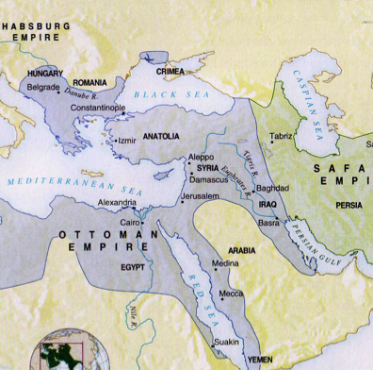
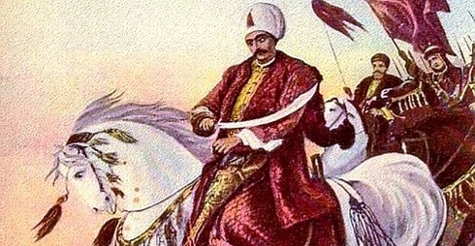
Islamic Empires
Selim the Grim captured Mecca, Medina, & Cairo for the Ottomans

Slide 18
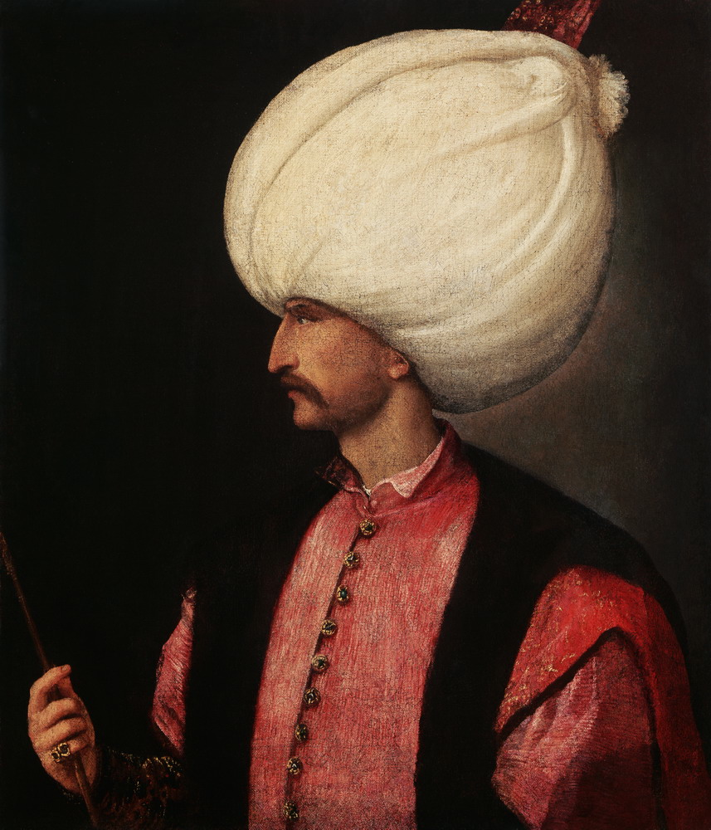
Islamic Empires
By 1526, Suleyman the Lawgiver controlled the Eastern Mediterranean Sea, added Tripoli in North Africa, and extended power into Europe; was most powerful Monarch on earth
Fun fact: Suleyman was fond of wearing big turbans.

Slide 19
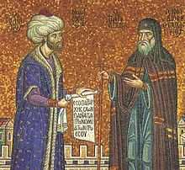
Islamic Empires
Why they are significant
The Ottomans acted kindly to those they conquered; often improved the lives of peasants living in their territories
Had one of the largest empires in history; lasted until World War I

Slide 20
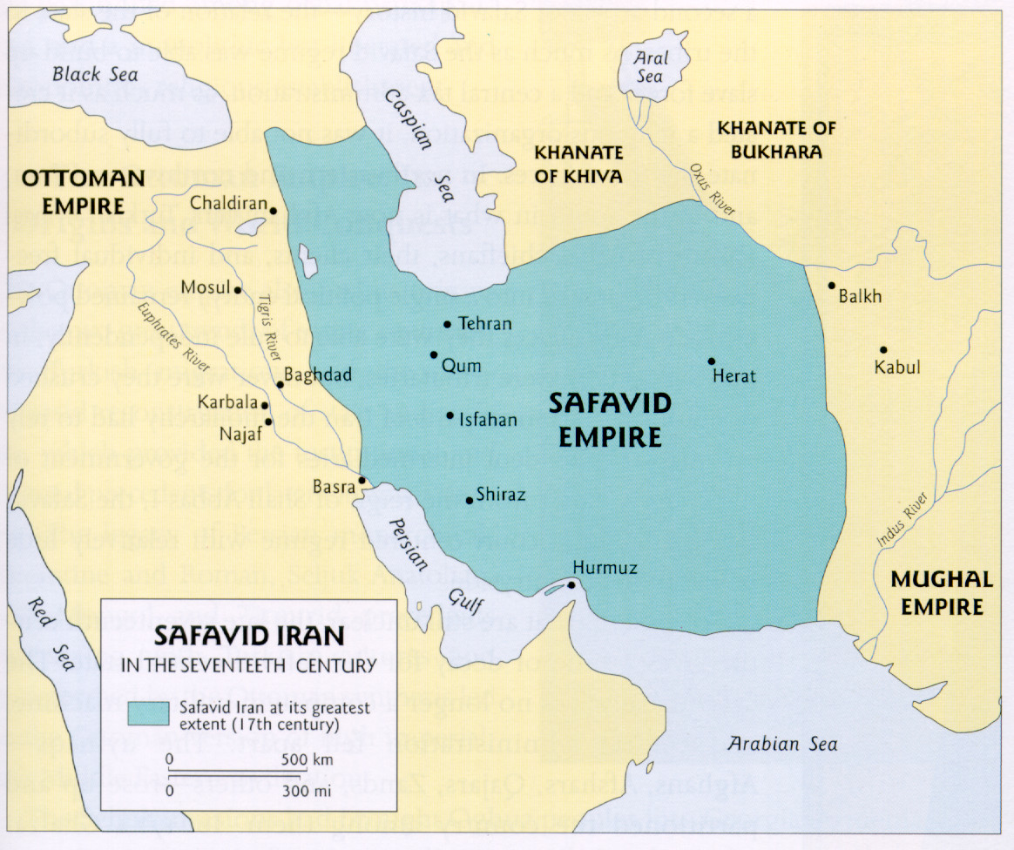
The Safavids

Slide 21
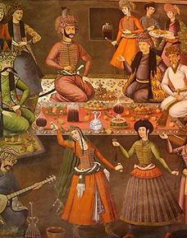
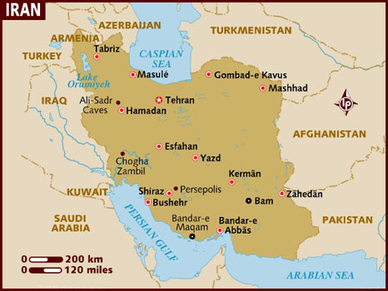
Islamic Empires
The Safavids
Where were they located?
East of Mesopotamia but West of India
Part of the former Persian Empire

Slide 22
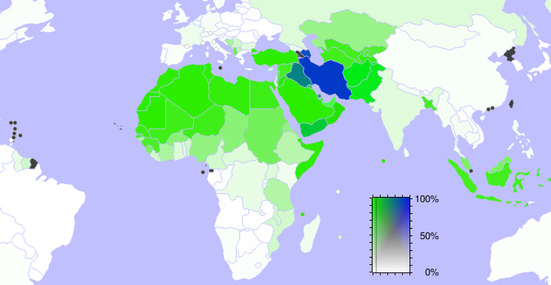
Islamic Empires
Who were they?
Part of the Shi’a branch of Islam
Concentrated on building a powerful army

Slide 23
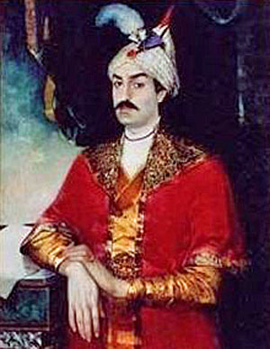
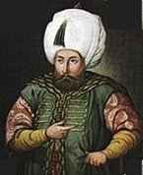
Islamic Empires
In 1501, Isma’il conquered modern day Iran; gave himself Persian title of Shah & established Shi’a Islam in that region (Still there today)
Isma’il was a religious tyrant who put anyone to death who didn’t covert to Shi’ism; also destroyed Sunni population
Ottoman leader Selim the Grim responded by ordering execution of upwards of 40,000 Shi’a in the Ottoman Empire
Shah Isma’il
Selim the Grim

Slide 24
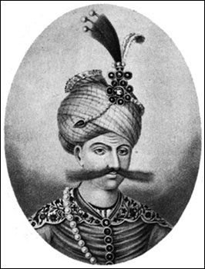
Islamic Empires
Shah Abbas reformed the Safavid military and civilian life
He also punished corruption severely and hired foreigners in the gov’t
Shah Abbas

Slide 25
Islamic Empires
Shah Abbas built beautiful city of Esfahan in Iran
Esfahan had beautiful woven carpets in the city
Esfahan had intricate calligraphy, metalwork, glass & tile work

Slide 26
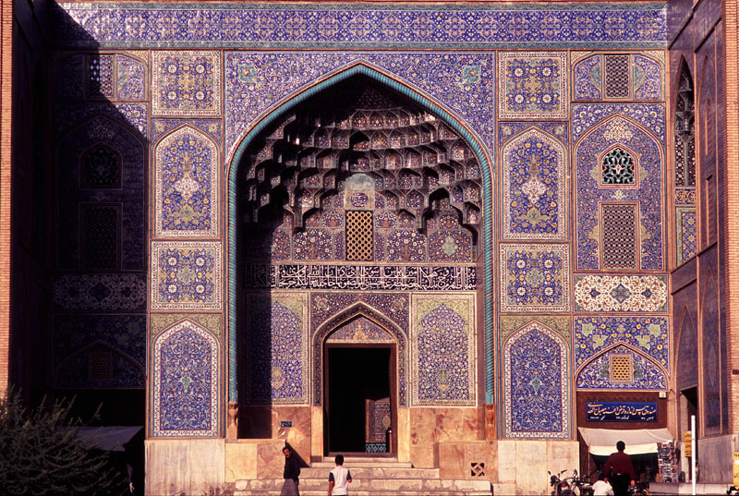
Esfahan

Slide 27
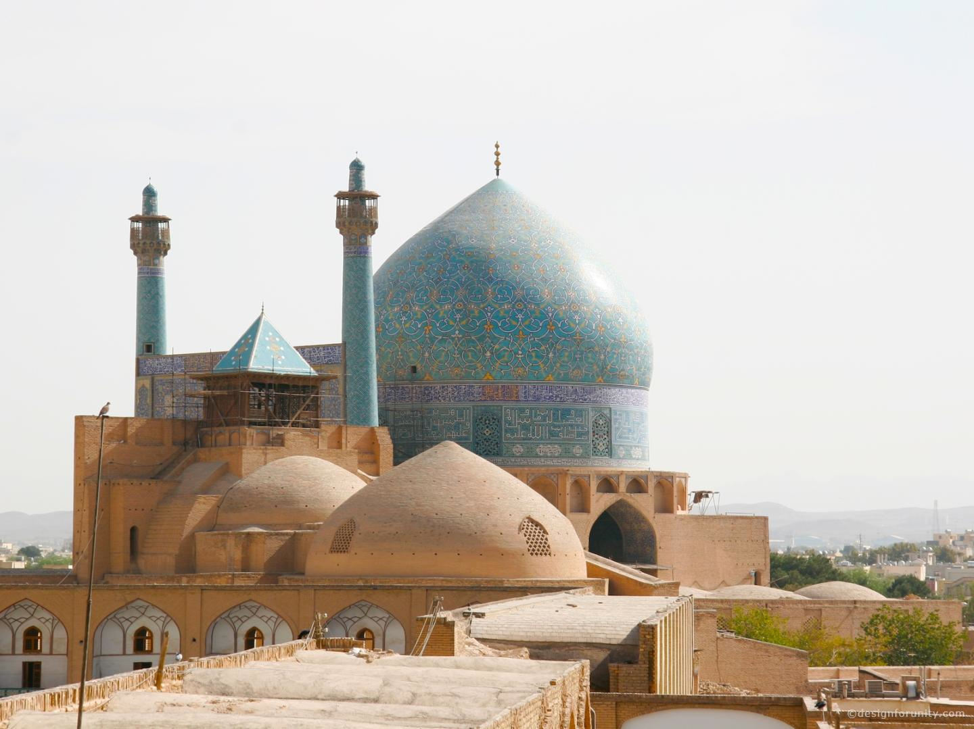
Esfahan

Slide 28
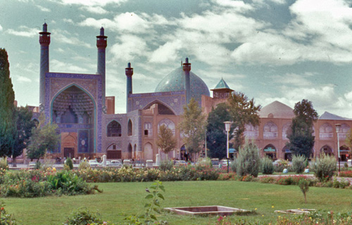
Esfahan

Slide 29
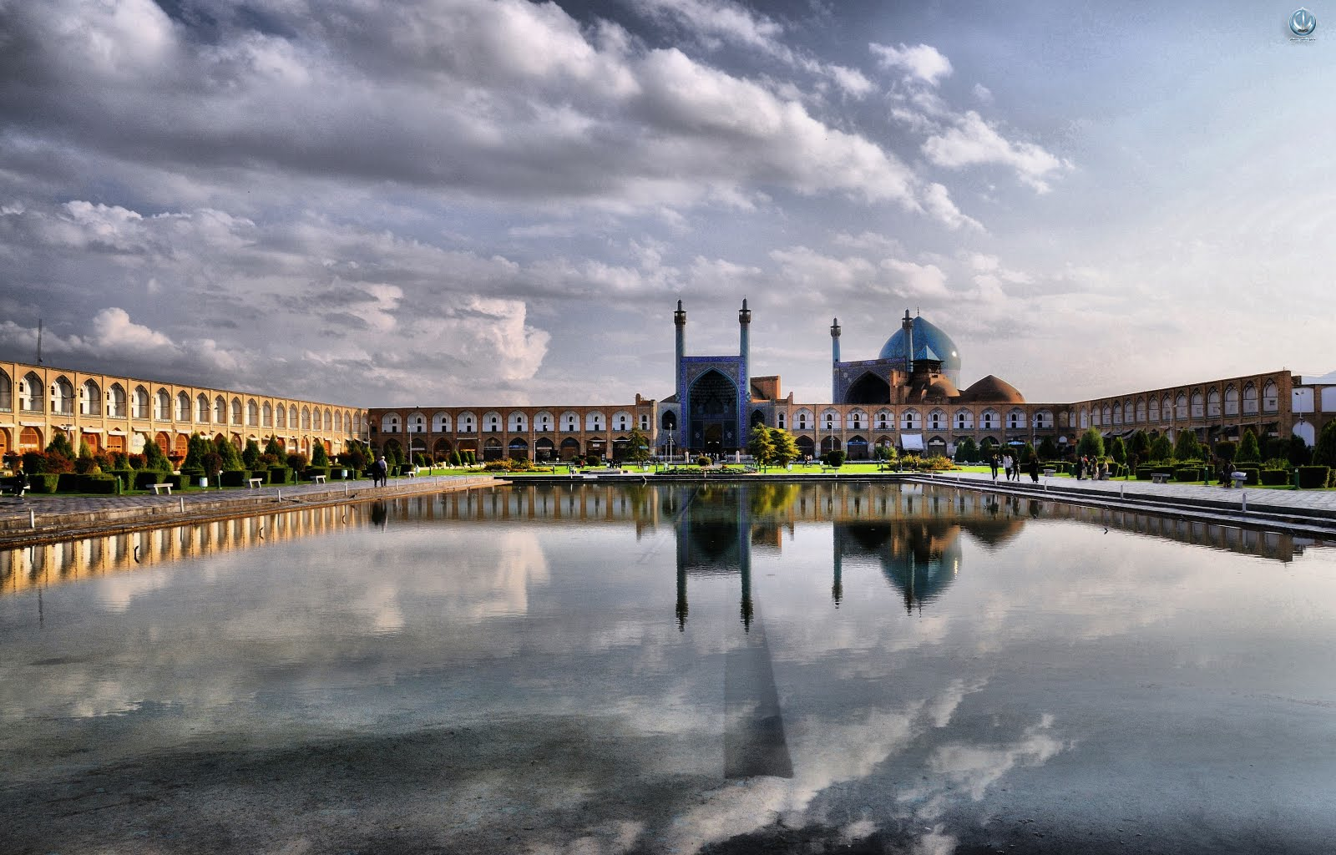
Esfahan

Slide 30
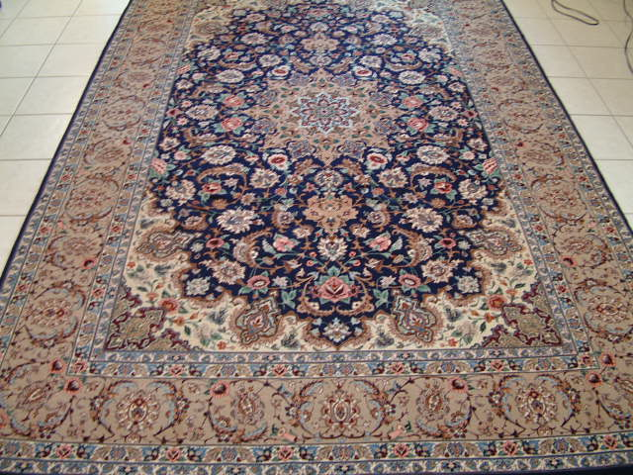
Woven Carpets

Slide 31
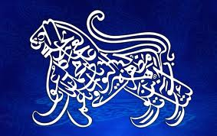
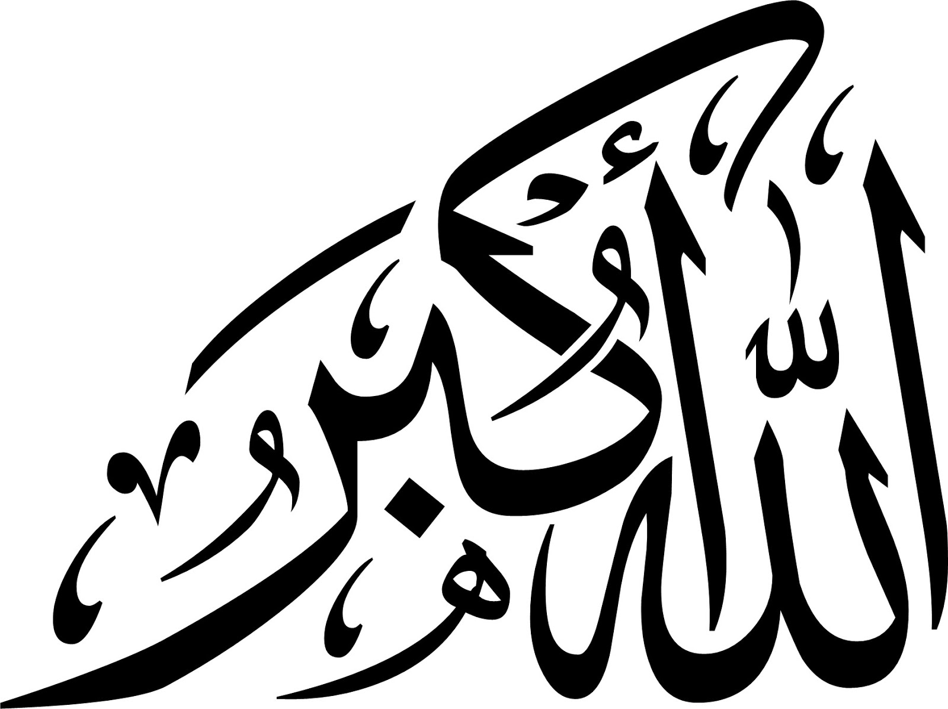
Islamic Calligraphy

Slide 32
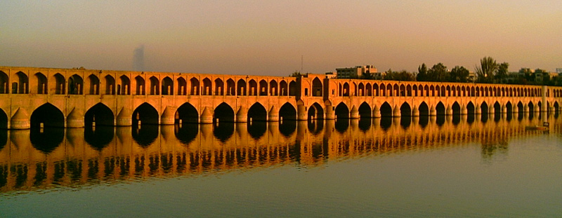
Islamic Empires
Why they are significant
Established Muslim dominance in modern day Iran
Created beautiful artwork still on display in Esfahan
Were an example of cultural blending of Persian, Ottoman, and Arab cultures

Slide 33
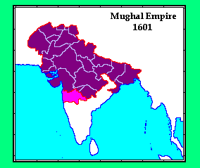
Islamic Empires
The Mughals
Where were they located?
Northern India eventually reaching Southern India

Slide 34
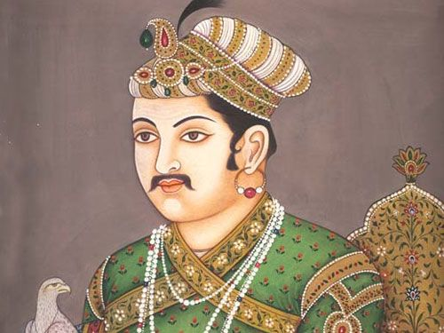
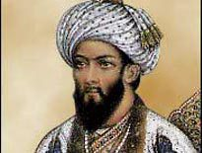
Babur & Akbar

Slide 35
Islamic Empires
Who were they?
Descendents of the Mongols
A brilliant general names Babur swept down into India and laid the foundation for the Mughal Empire
Babur’s grandson Akbar ruled India with tolerance from 1556-1605
Babur had a strong military backed with artillery/cannons which allowed him to move south into the Deccan Plateau
Unified a land of 100 million people
Babur believed in religious toleration; he married, among others, two Hindus, a Christian, and a Muslim

Slide 36
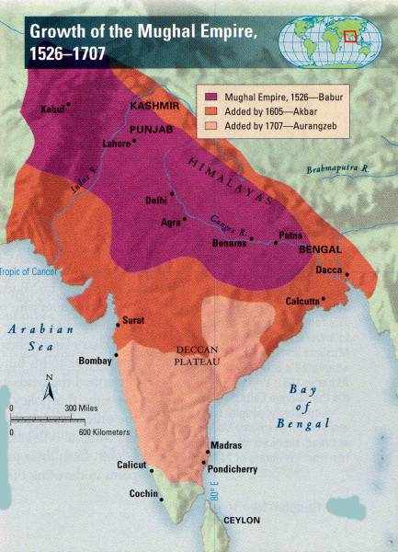

Slide 37
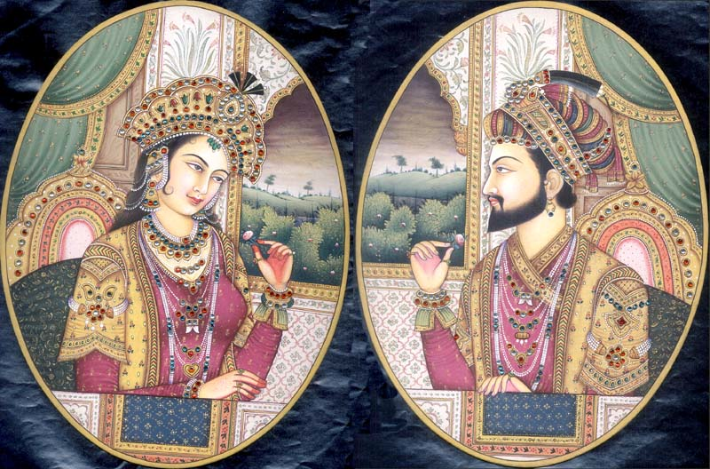
Islamic Empires
Art, architecture, language, and writing flourished under Akbar’s empire
Akbar’s grandson Shah Jahan built the beautiful Taj Mahal for his wife Mumtaz Mahal who died at age 39 giving birth to her 14th child

Slide 38
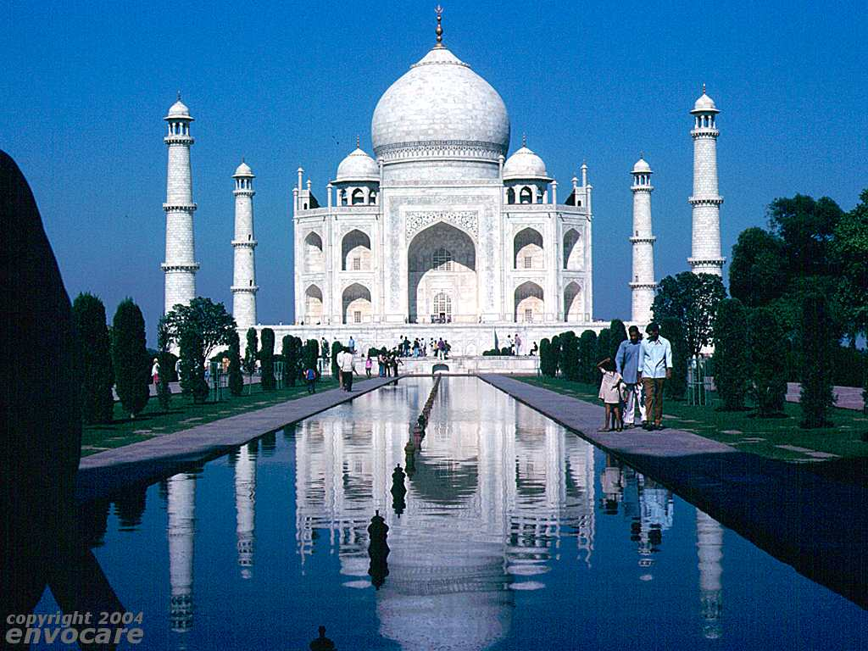
The Taj Mahal

Slide 39
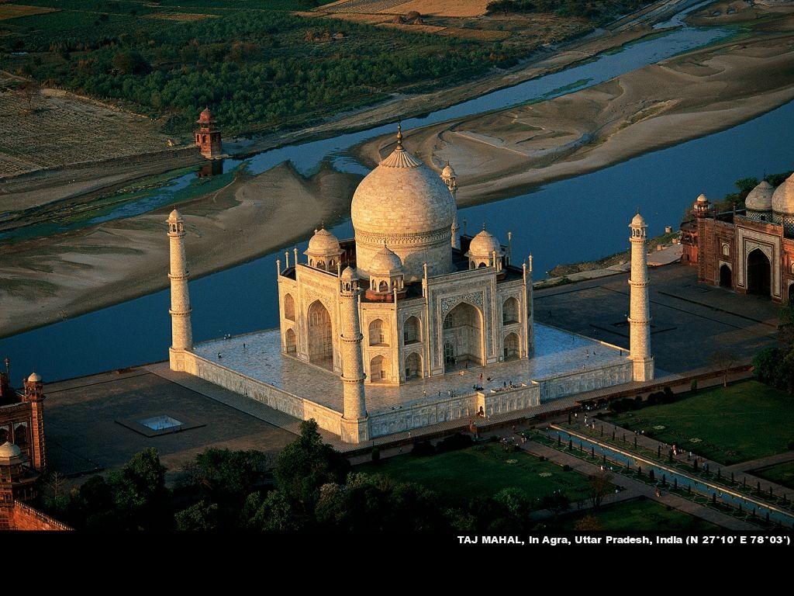

Slide 40
Islamic Empires
While Shah Jahan built, the country was hungry and suffering
Shah Jahan’s 3rd son Aurangzeb drained the empire of resources, 2 million people died of famine, his subjects weren’t loyal to him anymore and the empire was crumbling

Slide 41
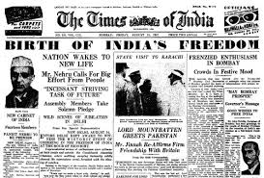
Islamic Empires
Why they are significant
The Taj Mahal has become one of the most iconic pieces of architecture in the world
The decline of the Mughals allowed for European traders to slowly come to dominate India, which will later lead to India’s independence movement

Slide 42
Islamic Empires
WAIT!!!!

Slide 43
Exit Assignment
At the bottom of your notes, write a 5-6 sentence summary about the Ottomans, Safavids, and Mughals.
I will check at the door on the way in.

