Slide 1
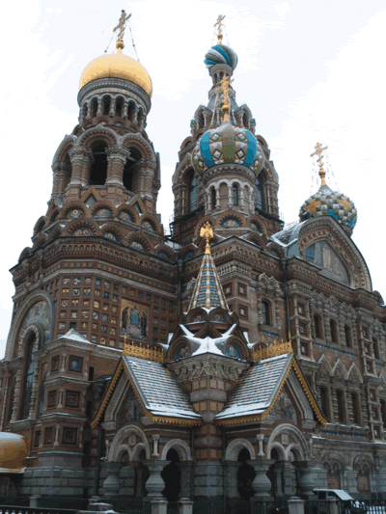
Russian Imperialism and Communism
Outcome: Absolute Rulers of Russia

Slide 2
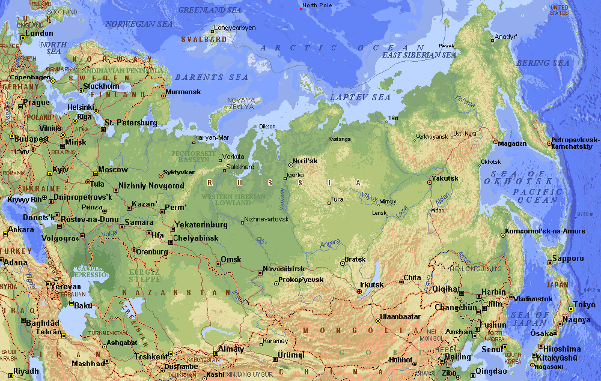
Russia Today

Slide 3
Former Soviet Region Compared in Latitude & Area with the United States

Slide 4
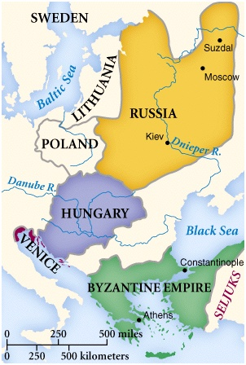
Early Russia

Slide 5
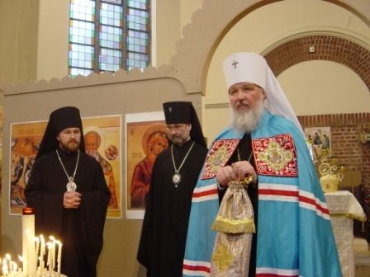
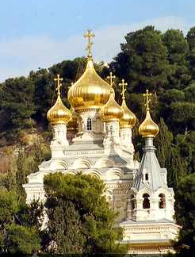
Early Byzantine Influences: Orthodox Christianity

Slide 6
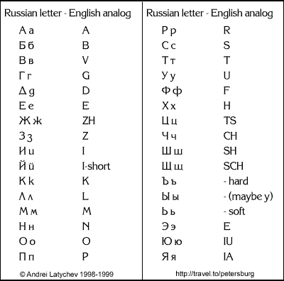
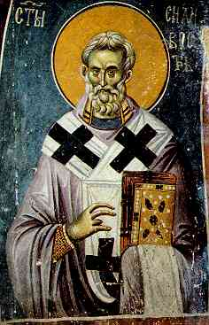
Early Byzantine Influences: Cyrillic Alphabet

Slide 7
Absolute Rulers of Russia
Setting the State
Czar: Russian emperor (from Roman title Caesar)
Russia had been controlled by the Mongols and Tatars
Large region that is often cold and covers 15 time zones

Slide 8
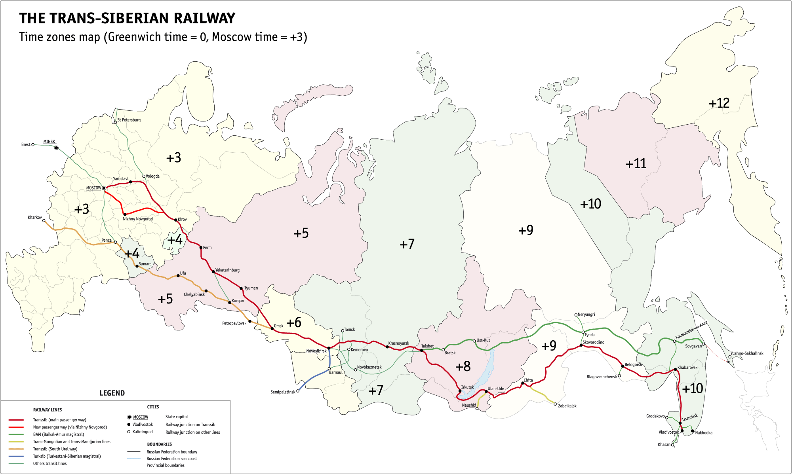
Russia’s Time Zones

Slide 9
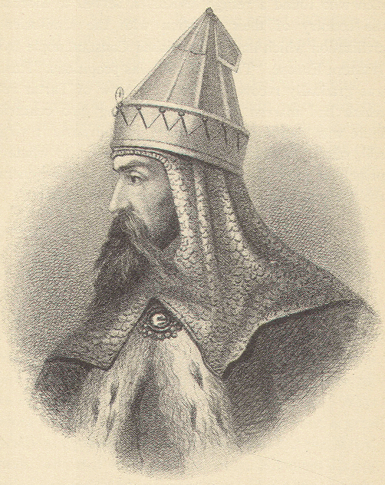
Ivan the Great

Slide 10
Absolute Rulers of Russia
Absolute Rulers of Russia
Ivan III (The Great)
Ruled Russia from 1462-1505
Conquered much of the territory around Moscow
Began to centralize the Russian government
Succeeded by son Vasily who ruled for 28 years

Slide 11
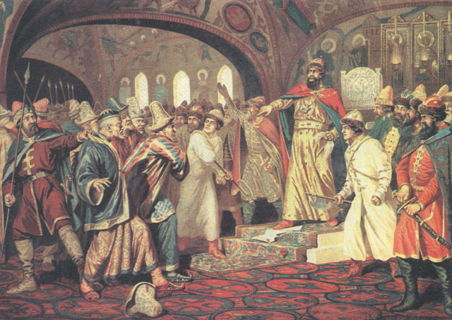
Ivan the Great (r. 1462-1505)
Ivan III Tearing the Great Khan’s Letter Requesting More Tribute in 1480.

Slide 12
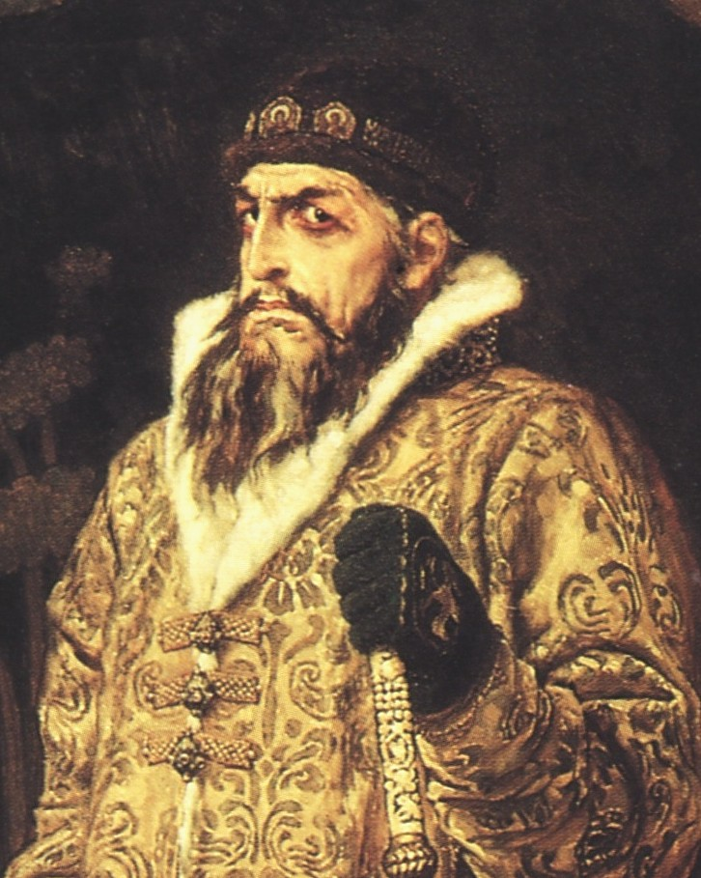
Ivan the Terrible

Slide 13
Absolute Rulers of Russia
Ivan The Terrible
Came to throne in 1533 at age 3
Ivan the Great’s grandson
At young age, was controlled by boyars or Russia’s landowning nobility
At age 16 he seized power and had himself crowned Czar
First Russian to use title Czar officially
1547-1560 was “good period”

Slide 14
Absolute Rulers of Russia
Ivan The Terrible Continued…
Bad period began in 1560
Wife Anastasia dies → Accuses boyars of poisoning her
Organizes police force to hunt down and murder people Ivan considered traitors: dressed in black and rode black horses
Many executed by secret police
Accidentally kills oldest son and heir
Ivan dies 3 years later leaving his weak second son to rule

Slide 15
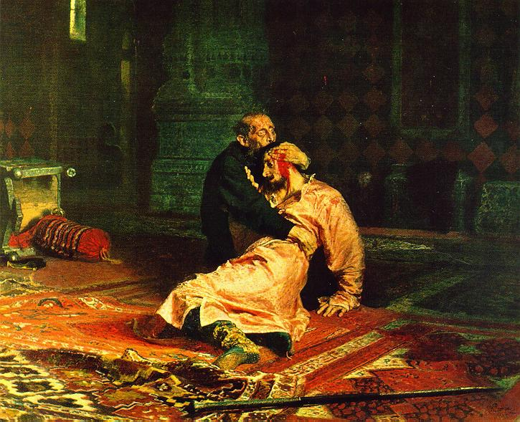

Slide 16
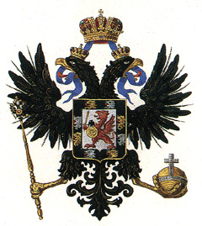
Romanov Dynasty (1613-1917)
Romanov Family Crest

Slide 17
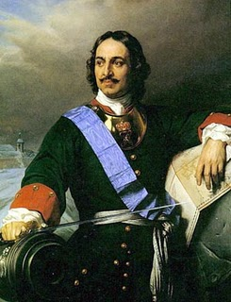
Peter the Great

Slide 18
Absolute Rulers of Russia
Peter the Great and Russia
Romanov dynasty begins in 1613
Romanovs strengthened government by passing a law code and putting down revolts which paved way for absolute rule of Czar Peter I
Peter the Great is known as one of Russia’s greatest reformers
Russia had adopted the Eastern Orthodox branch of Christianity (Western Europe was mostly Catholic or Protestant)
Peter was only 24 when he became sole ruler
Reforms: reduced power of great landowners, recruited men from lower classes and promoted them with grants of land, modernized his army

Slide 19
Absolute Rulers of Russia
Peter visits western Europe and comes back ready to westernize Russia
Introduces potatoes- staple part of Russian diet
Started Russia’s first newspaper and edited first issue
Raised women’s status by having them attend social gatherings
Ordered nobles to give up traditional clothes for Western fashions
Advanced education by opening a school of navigation and introducing schools for the arts and sciences

Slide 20
Absolute Rulers of Russia
St. Petersburg
Fought Sweden to gain land on Baltic Sea
Built new capital on swampy site
Would be an important shipping hub that would allow Russia to trade more easily
25,000-100,000 died building the city
Ordered nobles to leave Moscow and move to new city

Slide 21
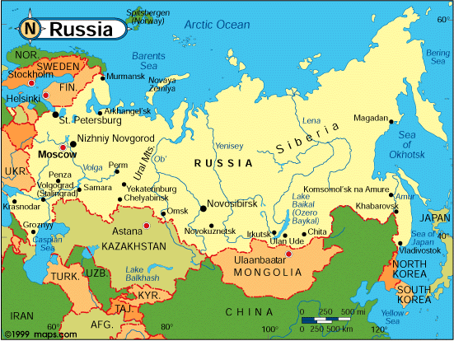

Slide 22
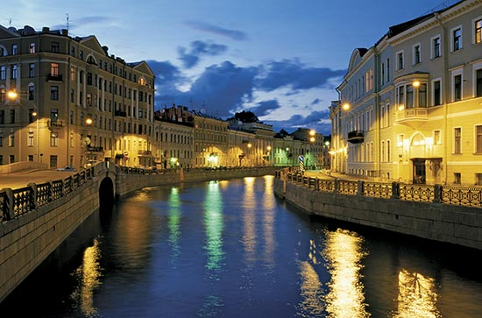

Slide 23
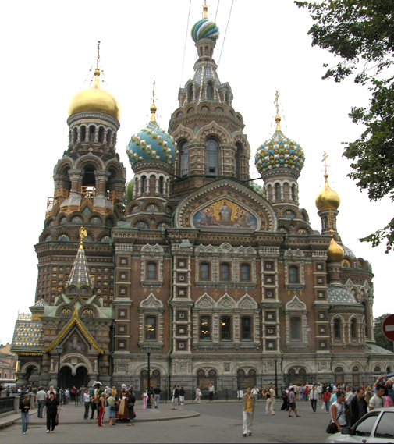

Slide 24
Absolute Rulers of Russia
Result: Peter had introduced Western ideas and reformed the culture and government of Russia with much success. By the time of his death in 1725, Russia was a force to be reckoned with.

Slide 25
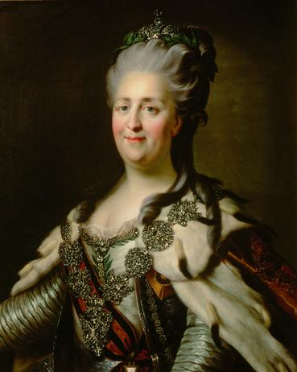
Catherine the Great

Slide 26
Absolute Rulers of Russia
Catherine the Great
Daughter of minor German prince
15 when married to Grand Duke Peter, heir to Russian throne
Peter was mentally unstable
Mere months after her husband became Czar, she had him arrested and confined
Peter conveniently died soon after, murder?
Sought access to the Black Sea- fought two wars with Ottoman Turks to get it
Expanded empire into Poland
Overall, had impressive reign that added a lot of land to the empire

