Slide 1
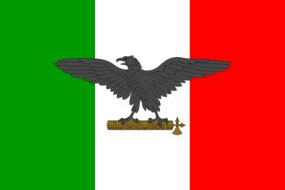
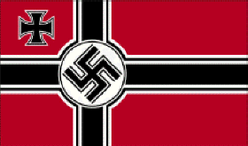
Fascism

Slide 2
A Definition of Fascism
Fascism is the totalitarian philosophy of government that glorifies the state and nation and assigns to the state control over every aspect of national life.
The State not only is authority which governs and molds individual will with laws and values of spiritual life, but it is also power which makes its will prevail abroad….For the Fascist, everything is within the State and…neither individuals nor groups are outside the State...For Fascism, the State is an absolute, before which individuals or groups are only relative….Liberalism denied the State in the name of the individual; Fascism reasserts the rights of the State as expressing the real essence of the individual. -- Enciclopedia Italiana, 1932

Slide 3
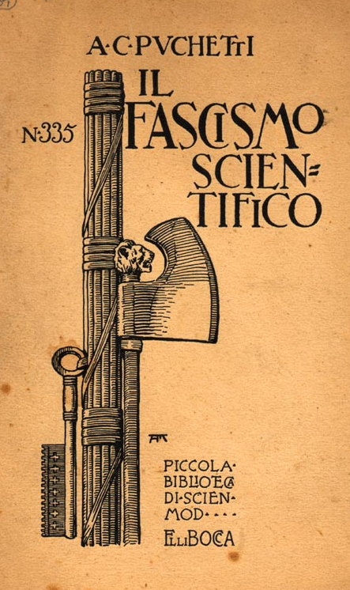
The Fasces Symbol
Comes from the Latin word fasces.
In ancient Rome, the fasces were cylindrical bundles of wooden rods, tied tightly together around an axe.
They symbolize unity and power.

Slide 4
The Characteristics of Fascism
As seen in Italy
(But Seen other places too!)

Slide 5
1. Ideology
A form of extreme right-wing ideology.
It celebrates the nation or the race as an organic community transcending all other loyalties.
Powerful and continuing nationalism.
Constant use of patriotic mottos, slogans, symbols, songs, etc.
Flags are seen everywhere.

Slide 6
2. Subordination to the State
Fascism seeks forcibly to subordinate ALL aspects of society to its vision of organic community [usually through a totalitarian state].
It uses organized violence to suppress opposition.

Slide 7
3. Cult of State Worship
The individual had no significance except as a member of the state.
The fascists were taught:
Credere! [to believe]
Obbedire! [to obey]
Combattere! [to fight]

Slide 8
4. The Myth of Rebirth
The “phoenix rising up from the ashes.”
Emphasis on a national or racial rebirth after a period of decline or destruction.
Seeks to purge “alien” forces and groups that threaten the organic community.

Slide 9
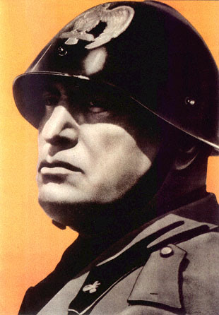
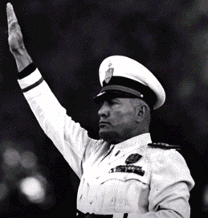
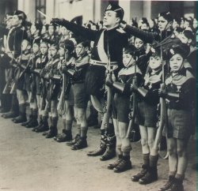
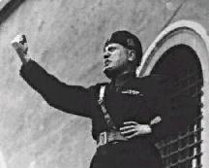
5. Militarism

Slide 10
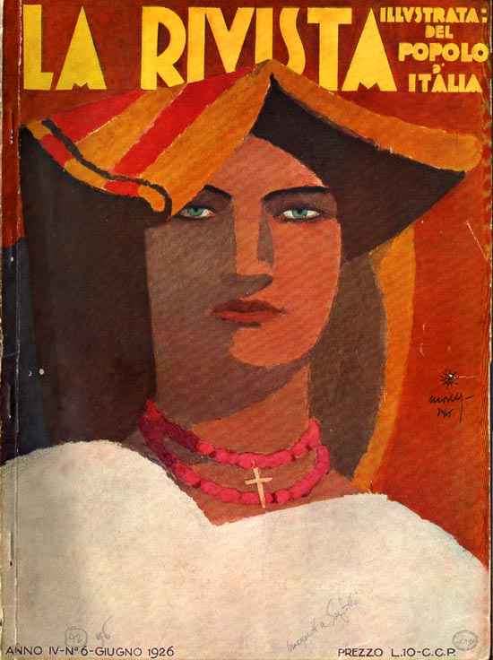
6. Rampant Sexism
Almost exclusively male-dominated.
Traditional gender roles are made more rigid.
The state is represented as the ultimate guardian of the family institution.

Slide 11
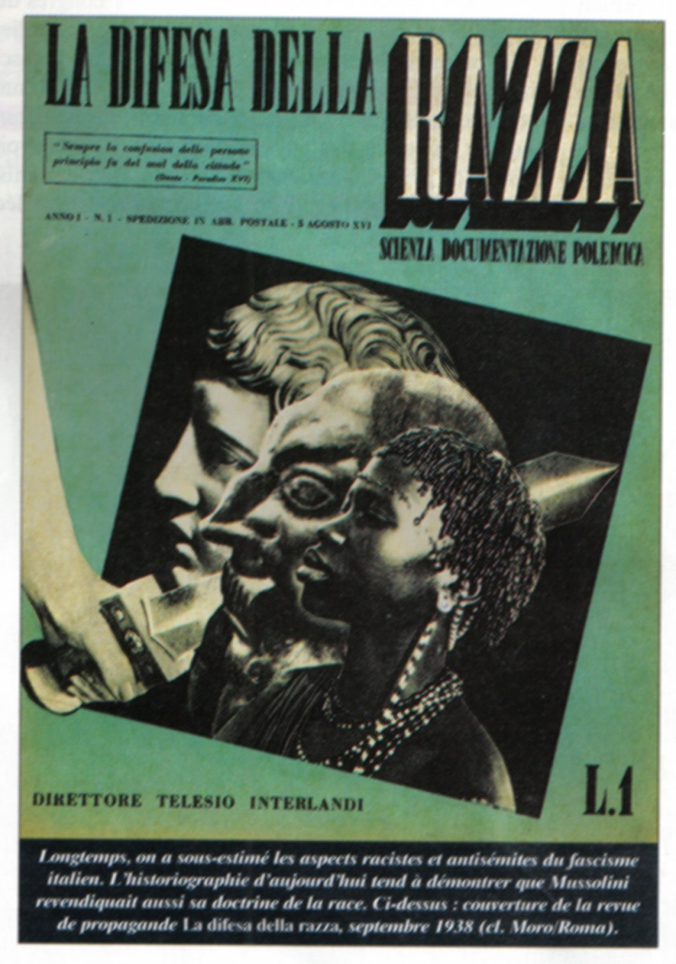
7. Identification of Enemies or Scapegoats as a Unifying Cause
The people are rallied into a unifying patriotic frenzy over the need to eliminate a perceived common threat or foe.
This foe could be racial, ethnic, a religious minority, liberals, communists, etc.

Slide 12
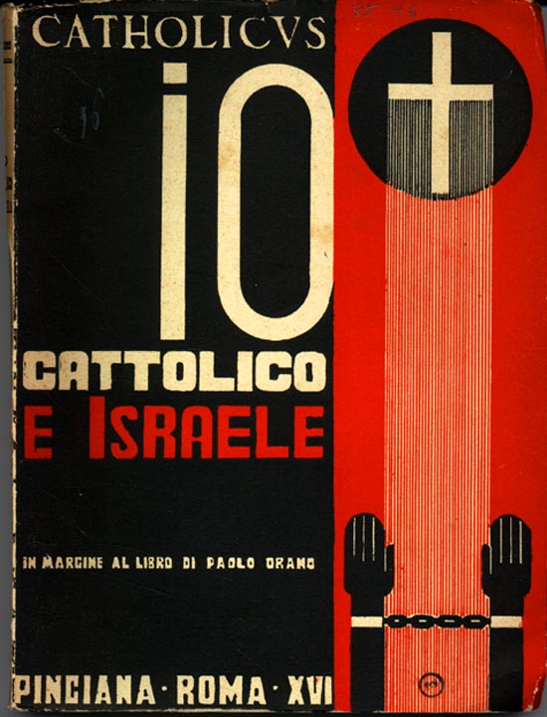
Jews Are the Enemy! (A common foe?)
This had become a very popular idea in many fascist states at this period of time in Europe!

Slide 13
8. Disdain for the Recognition of Human Rights
Because of the fear of enemies and the need for security, the people are persuaded that human rights can be ignored out of “need.”
People look the other way or even approve of torture, summary executions, long incarcerations of prisoners, assassinations, etc.

Slide 14
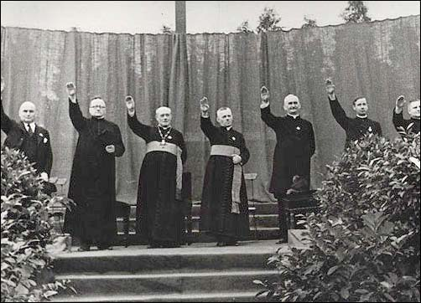
9. Religion & Government Are Intertwined
Fascist governments tend to use the most common religion in the nation as a tool to manipulate public opinion.

Slide 15
10. Disdain for Intellectuals & for the Arts
Open hostility to higher education and academia is promoted.
Professors and other academics are censored or arrested.
Free expression in the arts and letters is openly attacked.

Slide 16
11. Rampant Cronyism & Corruption
Fascist regimes are almost always governed by groups of friends and associates who appoint each to government positions.
This group uses governmental power and authority to protect their friends from accountability.

Slide 17
12. Fraudulent Elections
Sometimes elections are a complete sham.
Other times, elections are manipulated by smear campaigns against or even assassination of opposition candidates.
The use of legislation to control who can vote.

Slide 18
13. Controlled Mass Media

Slide 19
14. Labor Power is Suppressed; Corporate Power is Protected
Because the organizing power of labor is the only real threat to a fascist government, labor unions are suppressed or independent unions are eliminated.
The industrial and business aristocracy of a fascist state often are the ones who put the government leaders into power.
This creates a mutually beneficial business/government relationship and power elite!

Slide 20
The Rise of Mussolini

Slide 21
Immediate Post-WW I Italy
Fascism, to some extent, was a product of a general feeling of anxiety and fear among the middle class of post-war Italy:
Fears regarding the survival of capitalism.
Economic depression.
The rise of a militant left.
A feeling of national shame and humiliation at Italy’s poor treatment by the other Entente leaders after World War I [especially at Versailles].

Slide 22
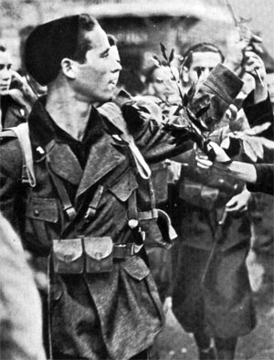
Immediate Post-WW I Italy
In 1920 the Italian Socialist Party organized militant strikes in Turin and other northern Italian industrial cities.
Hundreds of new fascist groups developed throughout Italy in response → “Black Shirts” [paramilitary squadriste] violently attacked the Socialists.

Slide 23
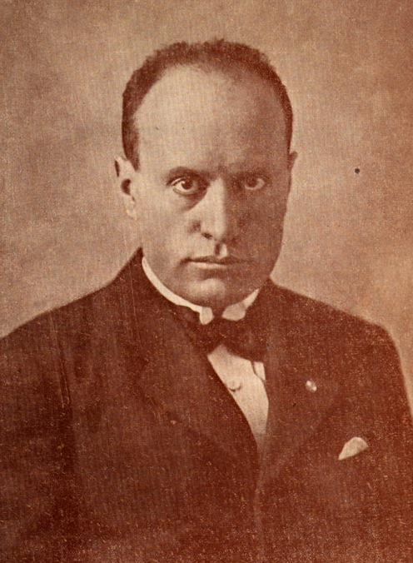
Benito Mussolini (1883-1945)
Originally a Marxist.
By 1909 he was convinced that a national rather than an international revolution was necessary.
Edited the Italian Socialist Party newspaper. Avanti! [Forward!].

Slide 24
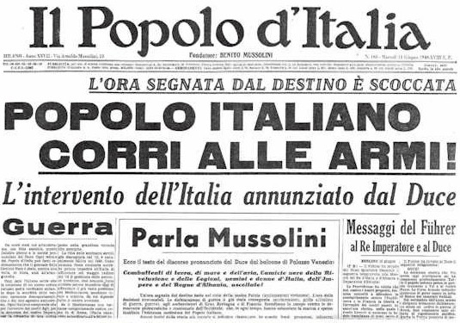
Benito Mussolini (1883-1945)
He became an interventionist.
Founded the newspaper Il Popolo d’Italia [The People of Italy] to encourage Italy to join the war.

Slide 25
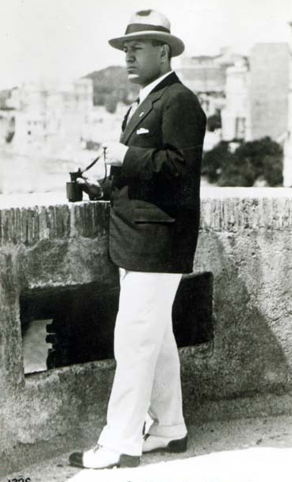
Benito Mussolini (1883-1945)
His editorial positions:
The war was a turning point for Italy.
The returning combat soldiers would form a new elite and bring about a new type of state.
This new elite would transform Italian politics and society!

Slide 26
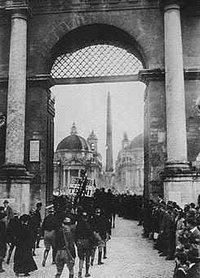
Mussolini Comes to Power
October, 1922 → Mussolini threatened a coup d’etat.
“March on Rome” → 25,000 Black Shirts staged demonstrations throughout the capital.

Slide 27
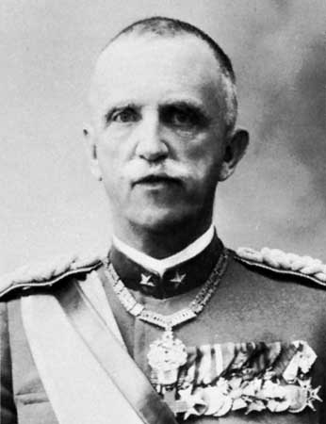
Mussolini Forms a Government
King Victor Emmanuel III invited Mussolini to join a coalition government with Giolitti.
1925 → Mussolini seized dictatorial powers during a political crisis [Black Shirts murdered one of Mussolini’s chief Socialist critics, Giacomo Matteotti].

Slide 28
The Fascists Consolidate Power (1925-1931)
New laws passed to create the legal basis for Italy’s official transformation into a single-party state:
Independent political parties & trade unions were abolished.
Freedom of the press was curbed.
Special courts created to persecute any political opposition.
National police force created [with a secret police component].

Slide 29
Italian Fascist Propaganda

Slide 30
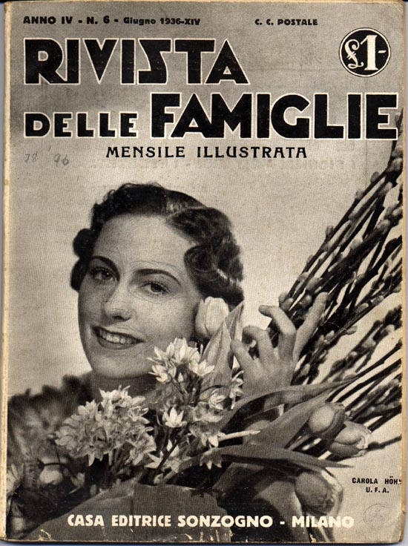
The Fascist Family
The Fascists encouraged the development of large families.

Slide 31
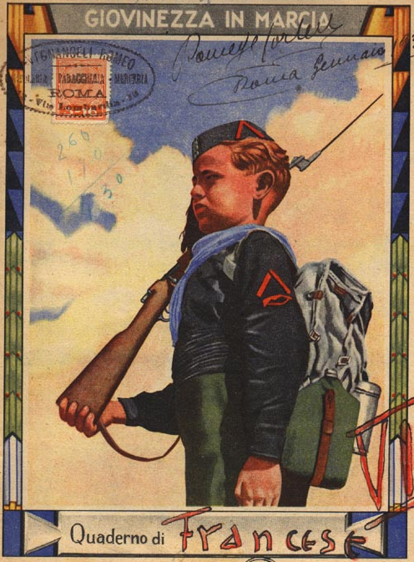
Education
The first sentence pronounced by children at school was Let us salute the flag in the Roman fashion; hail to Italy; hail to Mussolini.
Textbooks emphasized:
The glorious pat of the ancient Romans.
The limitations imposed upon the present inhabitants by geography and the West.
The imperial destiny that awaited Italy’s future development.

Slide 32
Emphasis on Physical Fitness

Slide 33
Anti-Semitism
50,000 Jews lived in Italy in the 1930s.
Mussolini did NOT implement an extermination program in Italy.
75% of Italian Jews survived World War II.
8,000 died in German extermination camps.
1938 →anti-Semitic laws passed
Manifesto degli Scienziati Razzisti [The Manifesto of the Racist Scientists].
Excluded foreign Jews [most of them were sent to German death camps].
Forbade all Jews from teaching.
Excluded Jews from serving in the government or in the military.

Slide 34
Mussolini Was Hitler’s Role Model

Slide 35
The Rise of
Hitler

Slide 36
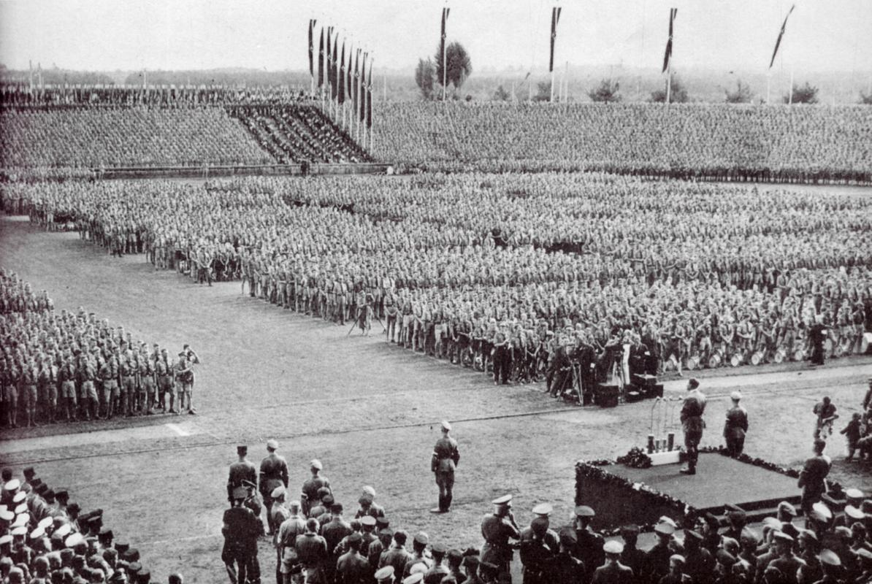
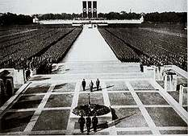
Fascism in Germany comes about
FASCISM – key characteristics:
the state supersedes the individual citizen (collectivism)
emphasis on militarism
the social contract is dissolved & replaced by a dictatorship
nat’lism assumes an extreme form & is used to appeal to the emotions & motivate populations (NUREMBERG RALLIES)
because of this, fascism is unique to the individual nation

Slide 37
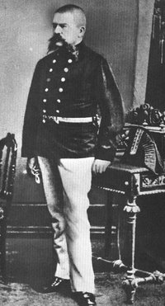
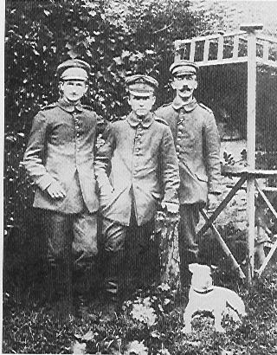
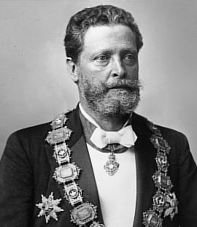
Hitler works to come to power
ALOIS SCHICKELGRUBER AND KLARA POLZL
VIENNA – KARL LUEGER
WWI AND THE VOLKISCH MOVEMENTS
GERMAN WORKERS’ PARTY

Slide 38
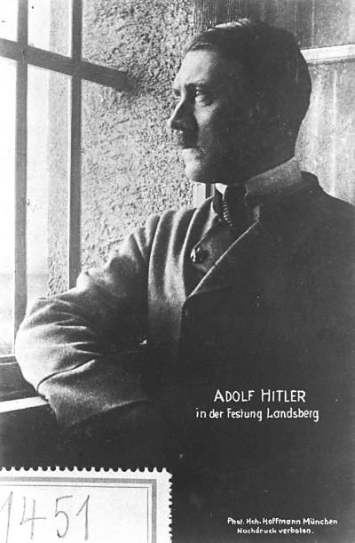
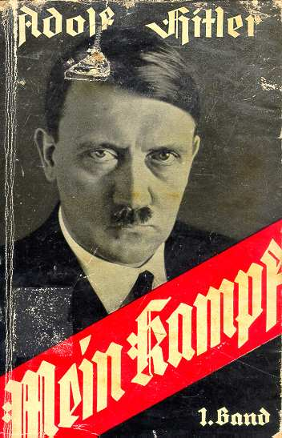
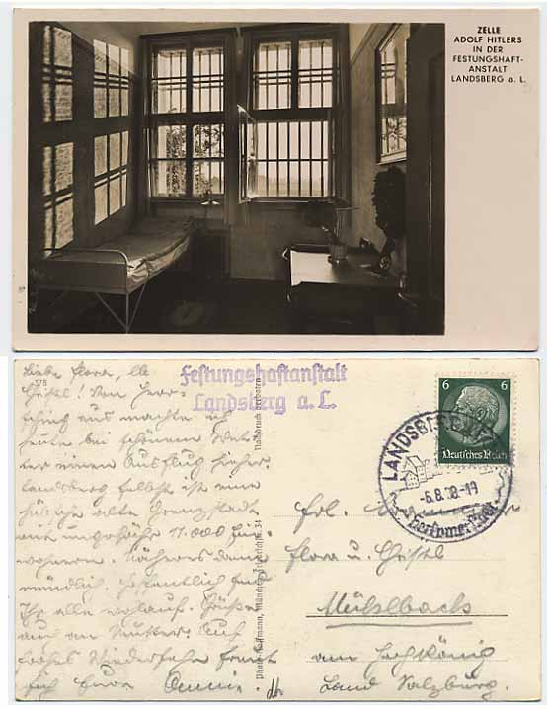
First Attempt = Failure
He went to LANDSBERG PRISON while in there he writes MEIN KAMPF.
“LEADER PARTY” AND THE VOLKSGEMEINSCHAFT
“GERMANY FLIGHTS” AND POLITICAL CAMPAIGNING- gains lots of backing from the people

Slide 39
Mar 21, 1933 – staged photo of Hindenburg and Hitler (after Hitler had won the Mar 5 elecs) –
Potsdam church – where Pr. kings had been crowned
Hitler was chancellor as of Jan. but he wanted a full majority
So Hindenburg was in full uniform (= mil. tradition)
Hitler in suit/civilian clothes and slightly bowing (thus not a mil. coup)
Goebbels wanted this to create continuity and more pop. support – the fact that all this was in a church further legitimized it – and the image showed that the army was ready to accept Hitler – the army was what worried him the most
So given the symbolism, there was little resistance – legitimacy instead of a rev!

Slide 40
Gains control--- and takes more power
THE REICHSTAG FIRE
A communist takes responsibility
So its time to kick them out of the government
THE DAY OF POTSDAM – HINDENBURG (president and him) Political unity
1933 – SO begins the THIRD REICH…

Slide 41
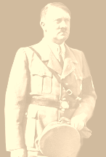
The Enabling ACT
With the Communists banned from the Reichstag Hitler was able to pass:
HITLER CAN
RULE ALONE
FOR FOUR
YEARS. THERE
IS NO NEED TO
CONSULT THE
REICHSTAG.
March 1933

Slide 42
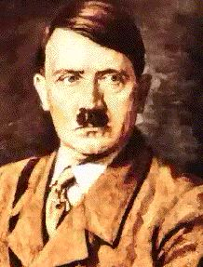
THE ENABLING ACT GAVE HITLER THE POWER TO MAKE HIS OWN LAWS. SO, HE BANNED ALL OTHER POLITICAL PARTIES!
SPD
KPD
SPD- Social Democrats KPD- Communists DDP- German Democratic Zentrum- German Centre Party (Catholic)
Zentrum
DDP

Slide 43
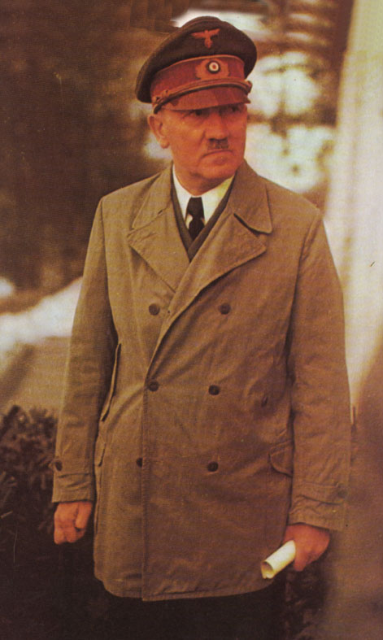
The night of LONG Knives
Now I have got rid of opposition political groups, I can now deal with opposition in my party. Ernst Rohm (an old friend), head of the S.A. is very unpopular with the German army leaders. They have the power to overthrow me. I’ve been worried about Rohm for a while, so this is a good excuse.
June 1934

Slide 44
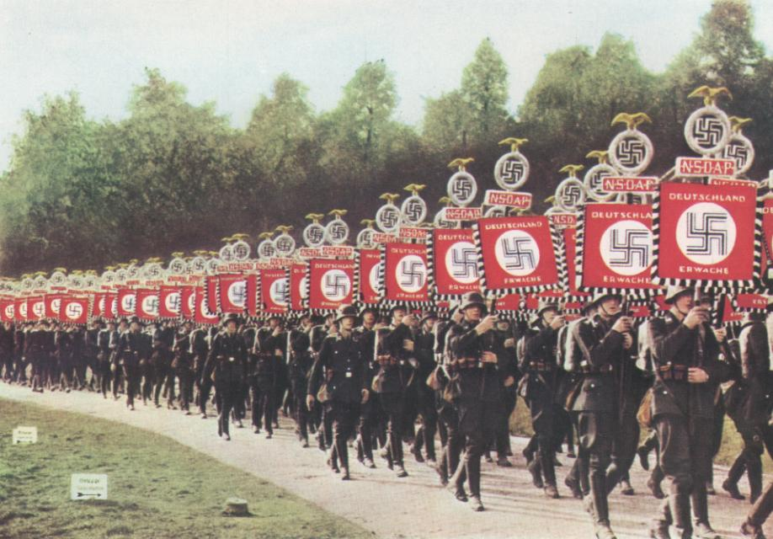
Oath of loyalty
to Adolf Hitler
Every soldier swore a personal oath of loyalty to ADOLF HITLER.

Slide 45
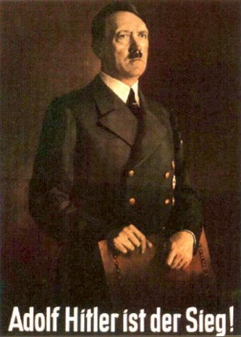
HITLER
BECAME
CHANCELLOR
THE
REICHSTAG
FIRE
THE
ENABLING
ACT
Der Fuhrer
OATH OF
LOYALTY
TO
HITLER
DEATH OF
PRESIDENT
HINDENBURG
THE NIGHT
OF THE
LONG
KNIVES

Slide 46
RECAP !!

Slide 47
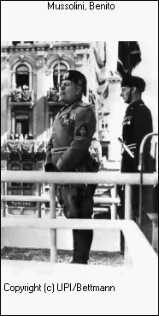
TOTALITARIANISM
Totalitarianism vs. Authoritarianism (Monarchy)
-Seek to dominate all -Seek limited, typically political
aspects of national life control
-Mobilize and make use -Seek pacified and submissive
of mass political populations
participation
-Seek the complete -Attempt to rule over the
reconstruction of the individual and society
individual and society

Slide 48
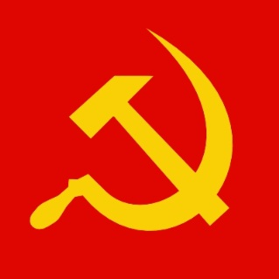
Joseph Stalin 1924
Country: Soviet Union
Type of Government: Communism (dictatorship)
Goals and Ideas:
Crushed opponents and took control after Lenin’s death
Held absolute authority; suppressed resistance
Brought his country to world power status but imposed upon it one of the most ruthless regimes in history
New Economic Policies (NEP)
Collectivization: exported seized goods and gained enough capital to finance a massive industrialization drive
Rapid industrialization: three 5-year plans
The Great Purges: KGB = secret police killed thousands of army officers and prominent Bolsheviks who opposed Stalin
Feared the growing power of Nazi Germany

Slide 49
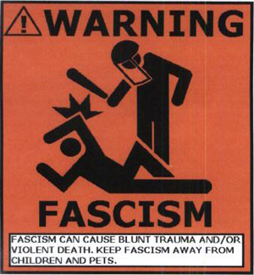
Benito Mussolini 1922
Country: Italy
Type of Government: Fascism (dictatorship)
Goals and Ideas:
Centralized all power in himself as leader (total control of social, economic, and political life)
Ambition to restore the glory of Rome
Invasion of Ethiopia
Alliance with Hitler’s Germany
Il Duce

Slide 50
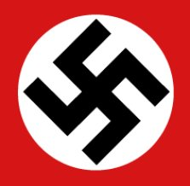
Adolf Hitler 1933
http://www.history.com/topics/the-holocaust/videos#adolf-hitler
Country: Germany
Type of Government: Nazism (dictatorship)
Goals and Ideas:
Inflation and depression weakened the democratic government in Germany and allowed an opportunity for Hitler to rise to power
Believed the western powers had no intention of using force to maintain the Treaty of Versailles
Anti-Semitism: persecution of Jews
Extreme nationalism: National Socialism (aka Nazism)
Aggression: German occupation of nearby countries
Lebensraum: unite all German speaking nations
Anschluss: German union with Austria

Slide 51
PLUS 1 MORE

Slide 52
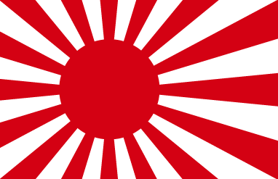
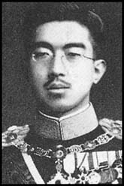
Hideki Tojo (by way of Hirohito)
Country: Japan
Type of Government: Militarism
Goals and Ideas:
Though Japan had an emperor, the military had taken control of the government
Emperor Hirohito could not stand up to the powerful generals, but he was worshipped by the people, who often fought in his name
Industrialization of Japan, lending to a drive for raw materials – how do you get raw materials? IMPERIALISM
Invasion of Korea, Manchuria, and the rest of China (the League of Nations did nothing)
Hideki Tojo, Military Leader of Japan
Hirohito, Emperor of Japan

