Slide 1
Age of Exploration
Lesson 5.3

Slide 2
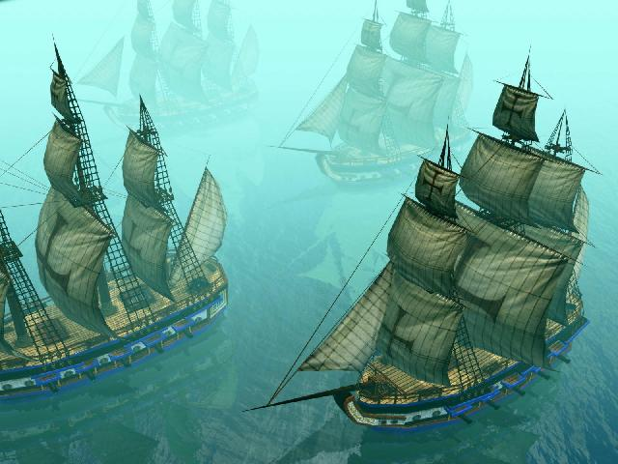
So now we know what the main reason, motivations…or roles the explores were working toward. (3 G’s).
But why during this time?
What allowed them to explore
Now ???
New technologies

Slide 3
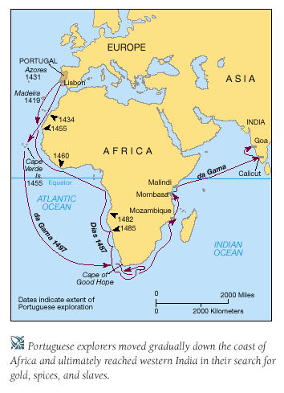
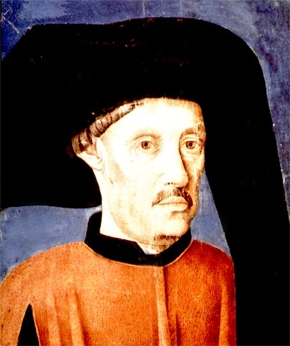
PRINCE HENRY “The Navigator”
The first to encourage new ship explorations was Prince Henry of Portugal, known as “Prince Henry the Navigator”
Started an institute for seafaring and exploring
Combined ship technology learned from Islam with new European innovations
By the time of his death in 1460, Portuguese had sailed as far south as the Gold Coast of West Africa
SSWH 10 (c) Explain the role of improved technology in European exploration; include the astrolabe.

Slide 4
Improvement #1- Improved Map making
Using reports of explorers and information from Arab geographers, European cartographers were able to create accurate land and sea maps.
They also created maps that showed exact location.
Better instruments were also developed for navigation.
SSWH 10 (c) Explain the role of improved technology in European exploration; include the astrolabe.

Slide 5
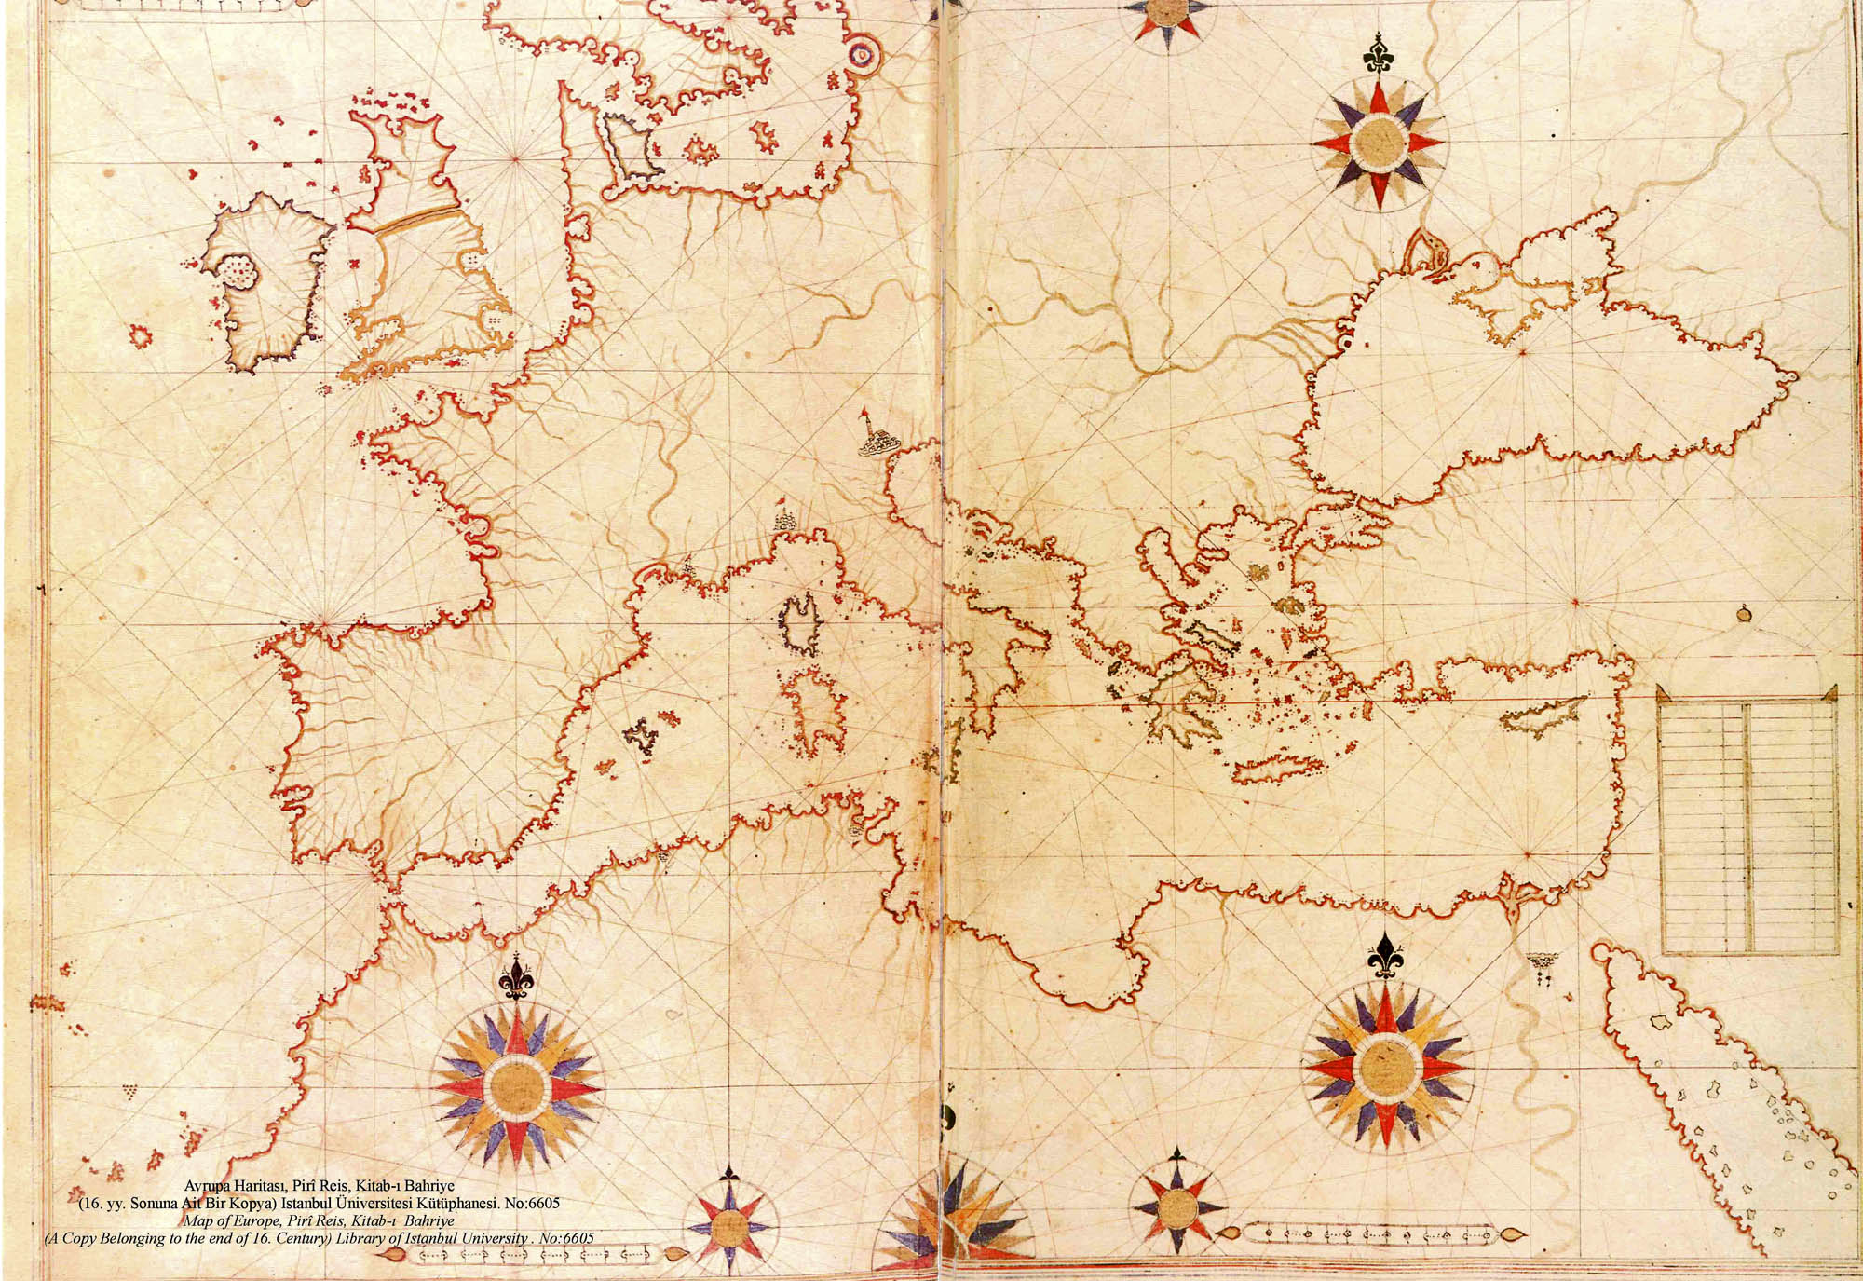
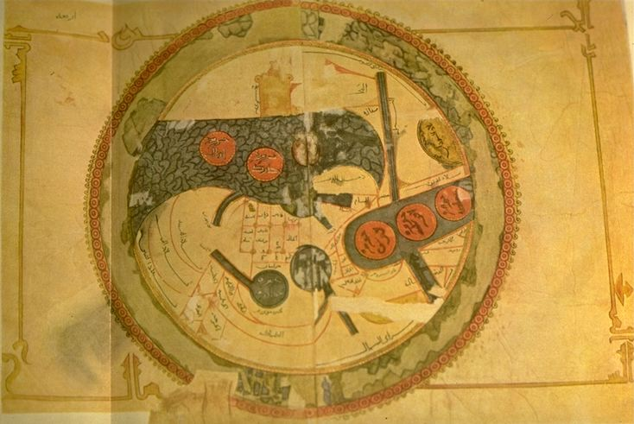
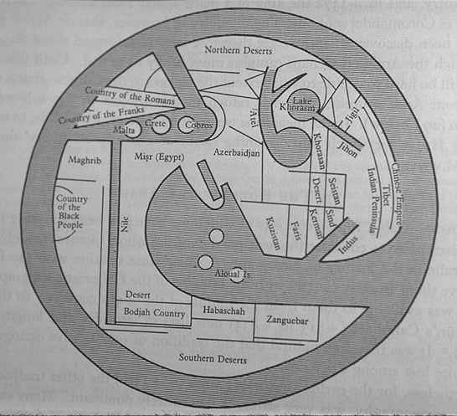
SO…What role does this play
in European Exploration?
What does it mean for European
Exploration?
SSWH 10 (c) Explain the role of improved technology in European exploration; include the astrolabe.

Slide 6
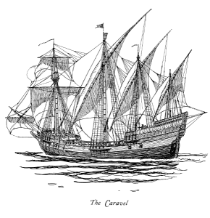
Improvement #2- Improved Ship building
The caravel was a new, faster, more maneuverable ship
Older ships had square sails, caravels had triangular sails (easier to change direction)
Bilge pump system enabled ship to float higher (less likely to run aground, easier to explore coasts and rivers)
SSWH 10 (c) Explain the role of improved technology in European exploration; include the astrolabe.

Slide 7
Improvement #3- Improved navigation equipment
Magnetic Compass- Compass that pointed toward the poles…so you could know your directions when far from home…and at night.
Astrolabe- measured the position of the starts, sun, and their position in the sky. (helped to determine latitude and if you were going in a straight line)
Later on
Sextant- invented in the 1600’s to measures two points in the sky (usually a star and the horizon)
SSWH 10 (c) Explain the role of improved technology in European exploration; include the astrolabe.

Slide 8
So Complete your standard…
Explain the role of improved technology in European exploration; include the astrolabe.
SSWH 10 (c) Explain the role of improved technology in European exploration; include the astrolabe.

Slide 9
Now for the Sciences

Slide 10
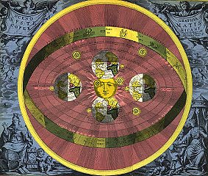
THE SCIENTIFIC REVOLUTION

Slide 11
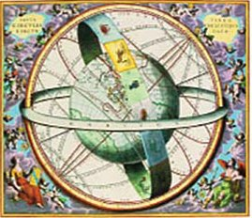
THE SCIENTIFIC REVOLUTION
CREATION OF A NEW WORLDVIEW
Questioning of old knowledge & assumptions
Gradual replacement of religious & superstition presumptions
Gradual rise of science & reason

Slide 12
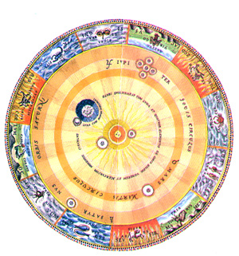
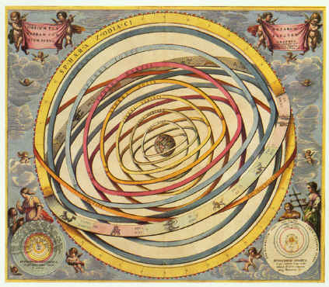
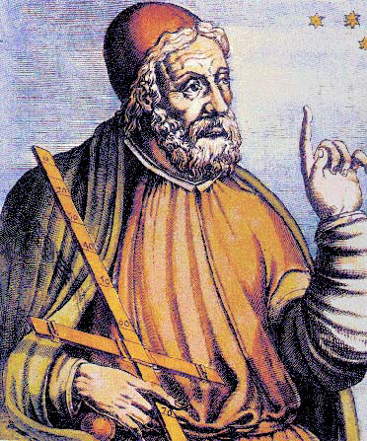
THE SCIENTIFIC REVOLUTION
NEW DIRECTIONS IN ASTRONOMY & PHYSICS
Geocentric Theory-Earth-centered view of the Universe
Idea began by Aristotle
Ptolemy- Expanded this theory

Slide 13
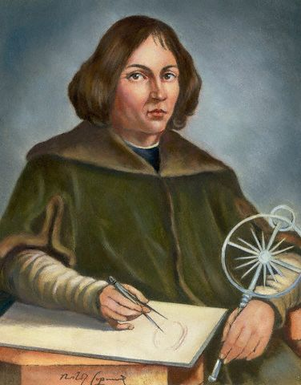
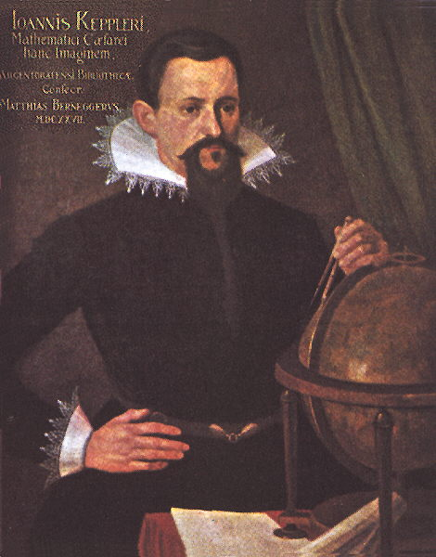
NEW DIRECTIONS IN ASTRONOMY & PHYSICS
NICOLAUS COPERNICUS (1473-1543):
Heliocentric Theory-Sun-centered view of the Universe
JOHANNES KEPLER, (1571-1630): Elliptical planetary movement

Slide 14
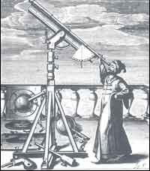
THE SCIENTIFIC REVOLUTION
NEW DIRECTIONS IN ASTRONOMY & PHYSICS
GALILEO GALILEI (1564-1642)
Constructed first telescope
Described motion of bodies on earth

Slide 15
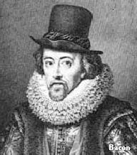
THE SCIENTIFIC REVOLUTION
PHILOSOPHICAL THOUGHT
FRANCIS BACON (1561-1626)
Inductive reasoning: working from particular to general conclusions
Empiricism & scientific method
Empiricism: theory of knowledge that asserts that knowledge comes only or primarily via sensory experience
Notes:
Inductive Example:

Slide 16
Inductive Reasoning
Here are a couple of examples:
Every time you eat shrimp, you get cramps. Therefore you get cramps because you eat shrimp." "Mikhail hails from Russia and Russians are tall, therefore Mikhail is tall." "When chimpanzees are exposed to rage, they tend to become violent. Humans are similar to chimpanzees, and therefore they tend to get violent when exposed to rage." "All men are mortal. Socrates is a man, and therefore he is mortal." "The women in the neighboring apartment has a shrill voice. I can hear a shrill voice from outside, therefore the women in the neighboring apartment is shouting

Slide 17
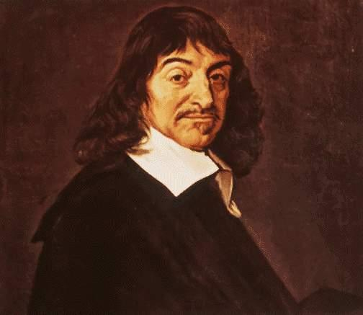
THE SCIENTIFIC REVOLUTION
PHILOSOPHICAL THOUGHT
RENÉ DESCARTES (1596-1650)
Geometry: any algebraic formula could be plotted as curve in space
Deductive Reasoning: starting with general assumptions & working downward
Cartesian Dualism: division of reality into “thinking substance” & “extended substance”

Slide 18
Deductive Reasoning
Examples of Deductive Reasoning All oranges are fruits All fruits grow on trees Therefore, all oranges grow on trees All bachelors are single Johnny is single, Hence, Johnny is a bachelor

Slide 19
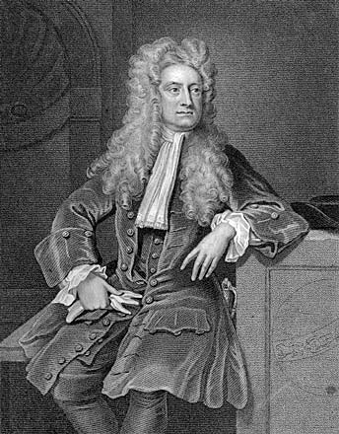
THE SCIENTIFIC REVOLUTION
NEW DIRECTIONS IN ASTRONOMY & PHYSICS
ISAAC NEWTON (1642-1727)
Universal Gravitation: combined laws of planetary & earth motion
Numerous practical applications

Slide 20
Newton’s Law of Gravitation
http://www.youtube.com/watch?v=Jk5E-CrE1zg&safety_mode=true&persist_safety_mode=1&safe=active

Slide 21
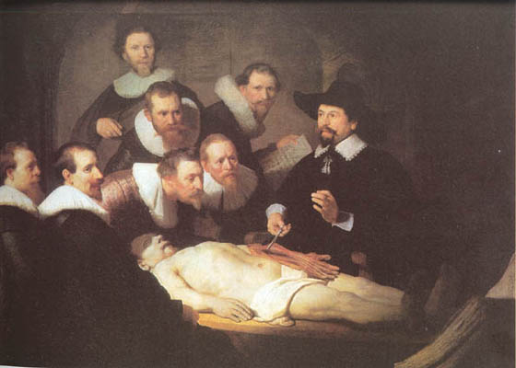
THE SCIENTIFIC REVOLUTION
DISCOVERIES IN OTHER SCIENCES
Botany: new medical applications
Anatomy: better understand of how human body worked
Microscope invented

Slide 22
And just for fun
http://youtu.be/jwPc0kK9VHU

